Slide 1


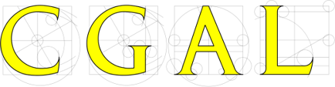
Alpha wrapping with AN offset
Cédric Portaneri, Mael ROUXEL-LABBé, Michael Hemmer, David Cohen-Steiner, pierre Alliez
Notes:
Todo:

Slide 2
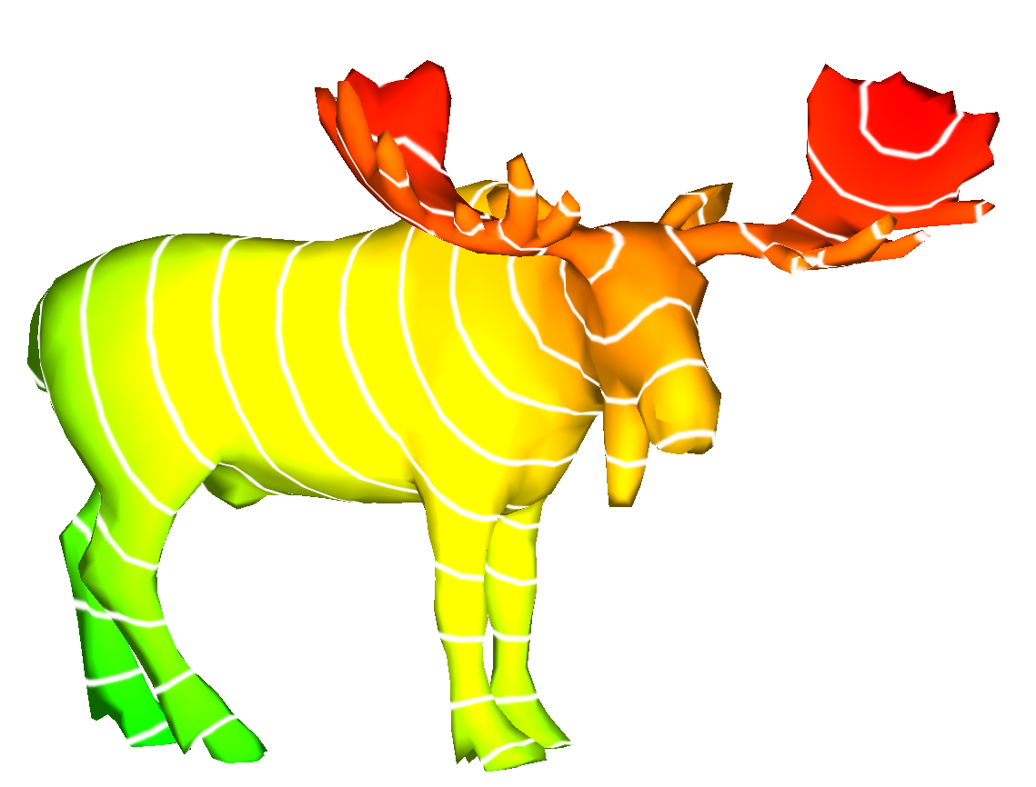
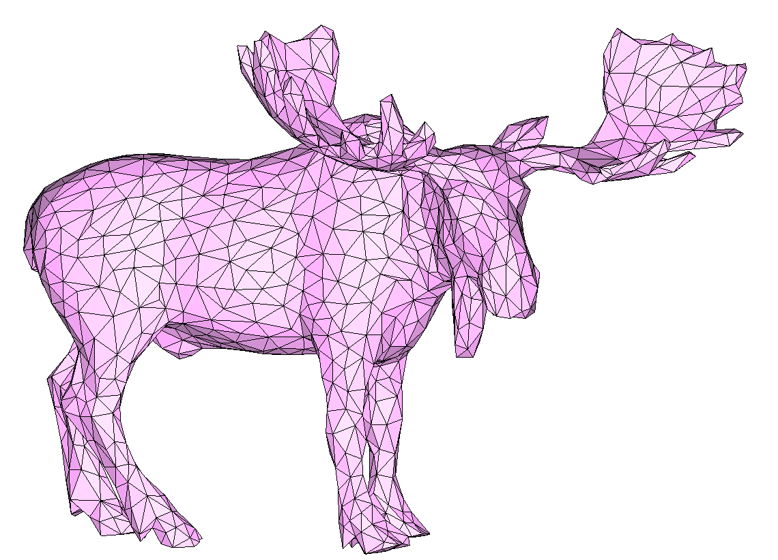
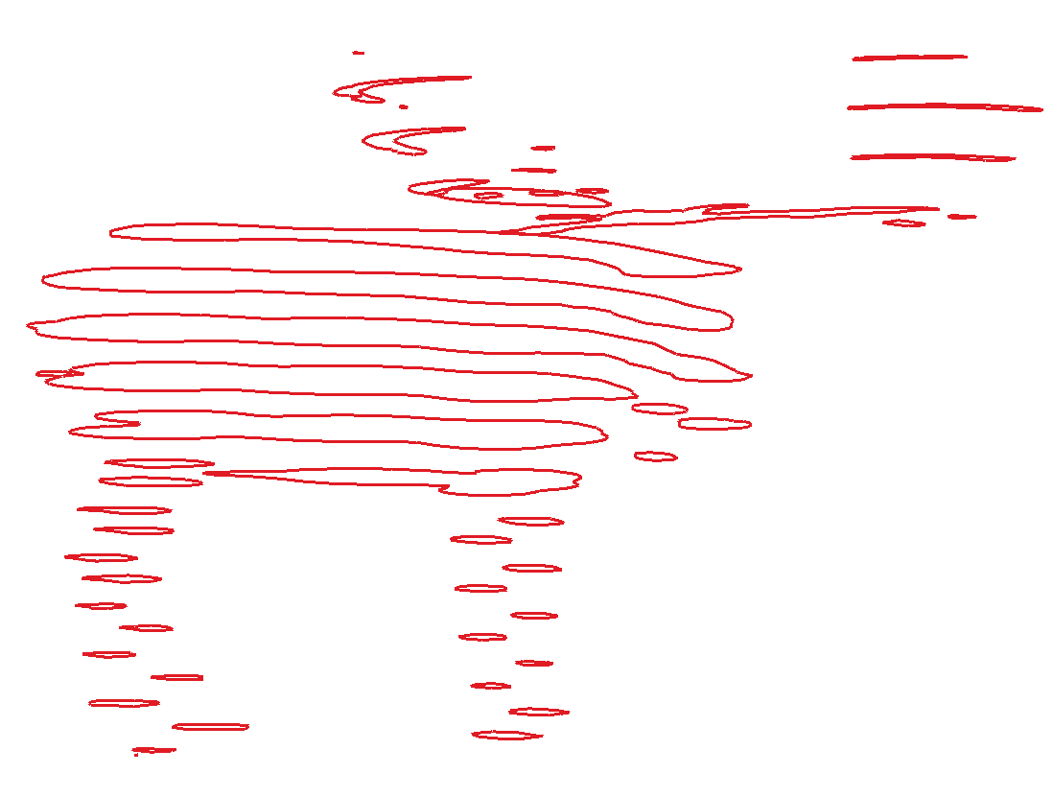
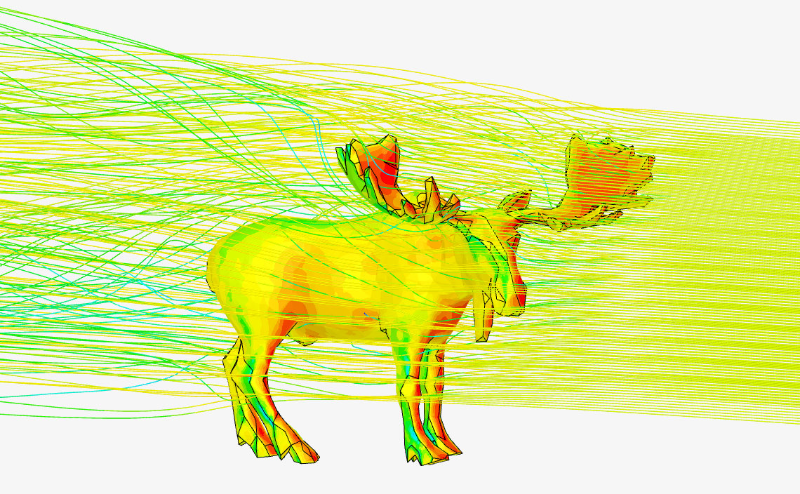
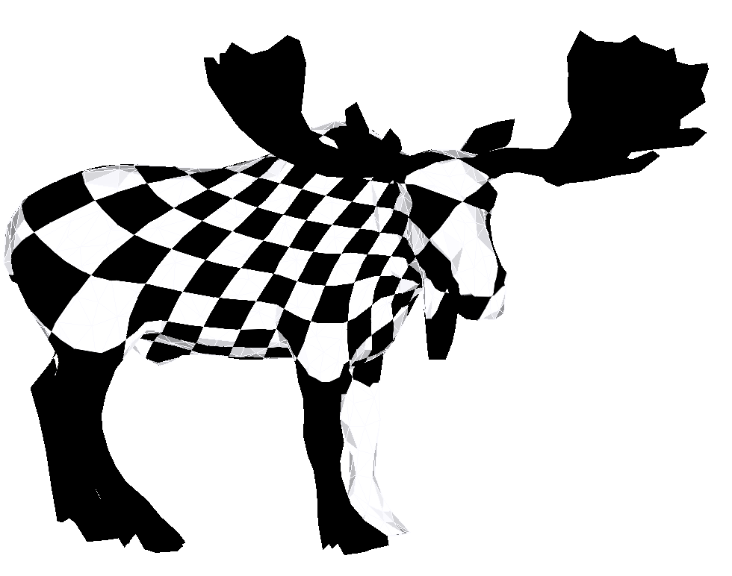
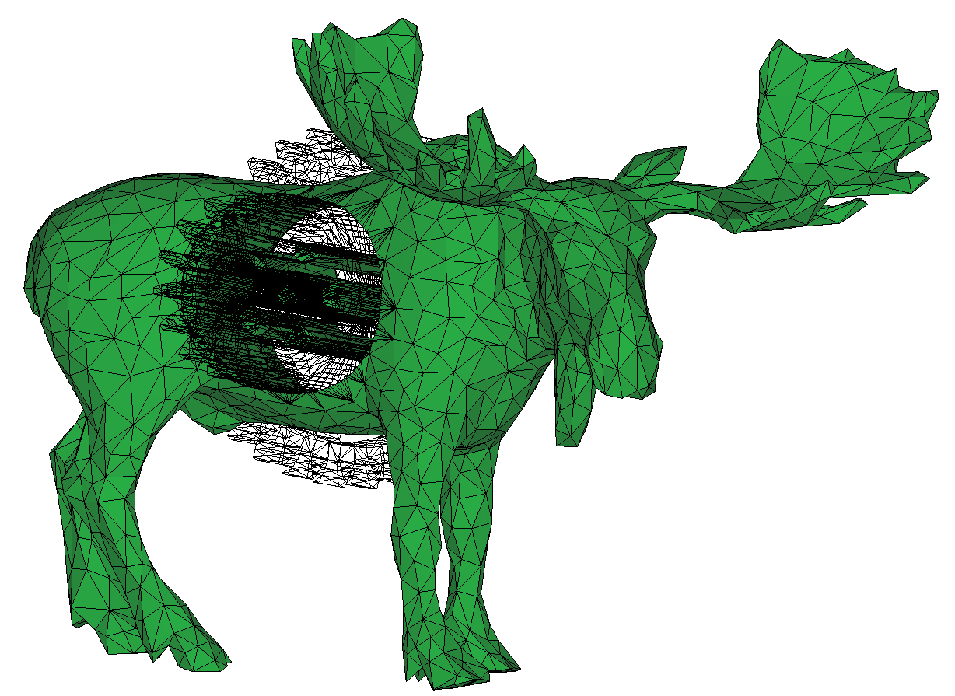
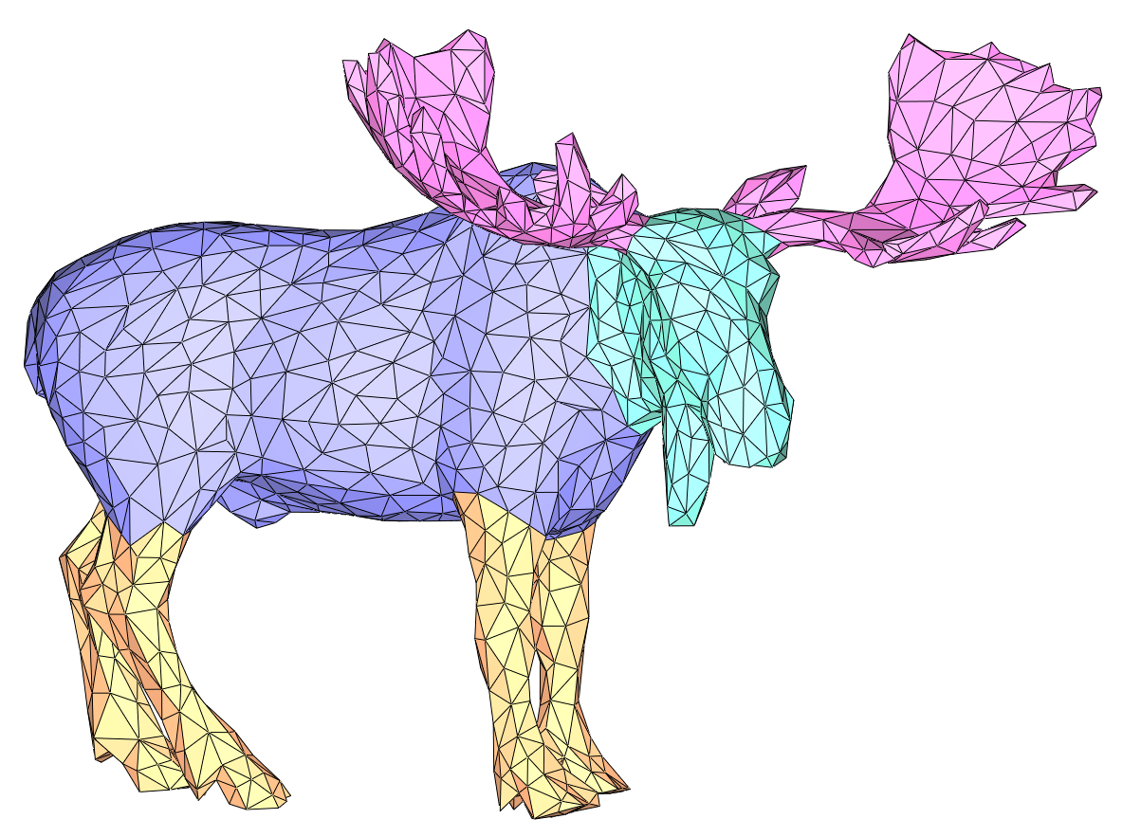
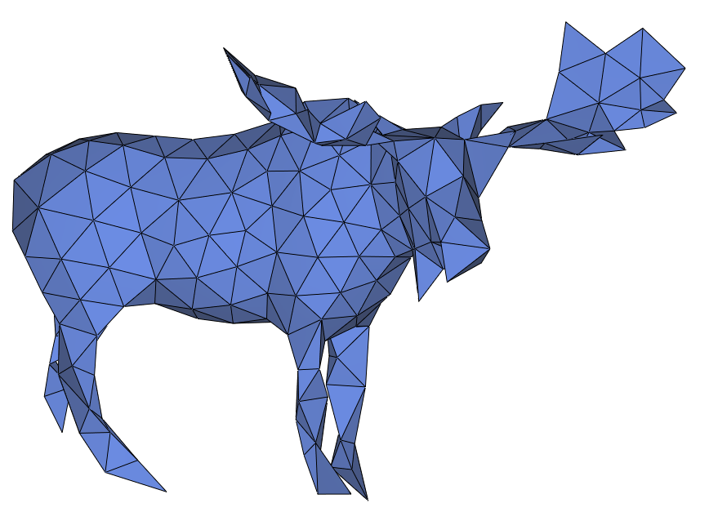
Motivation: Mesh validity
A mesh is valid if it is:
2-manifold combinatorially and geometrically
Without self-intersections
Mesh validity is crucial to many applications
Computing distances
Moose [Jérémie Louvetz]
Slicing
Parameterization
Boolean Operations
Segmentation
Remeshing & Simplification
Simulations
Notes:
Surface meshes are essential components in many geometry processing and computer graphics application. Most applications require, or at least prefer, input meshes that are combinatorially 2-manifold, watertight, and orientable.

Slide 3
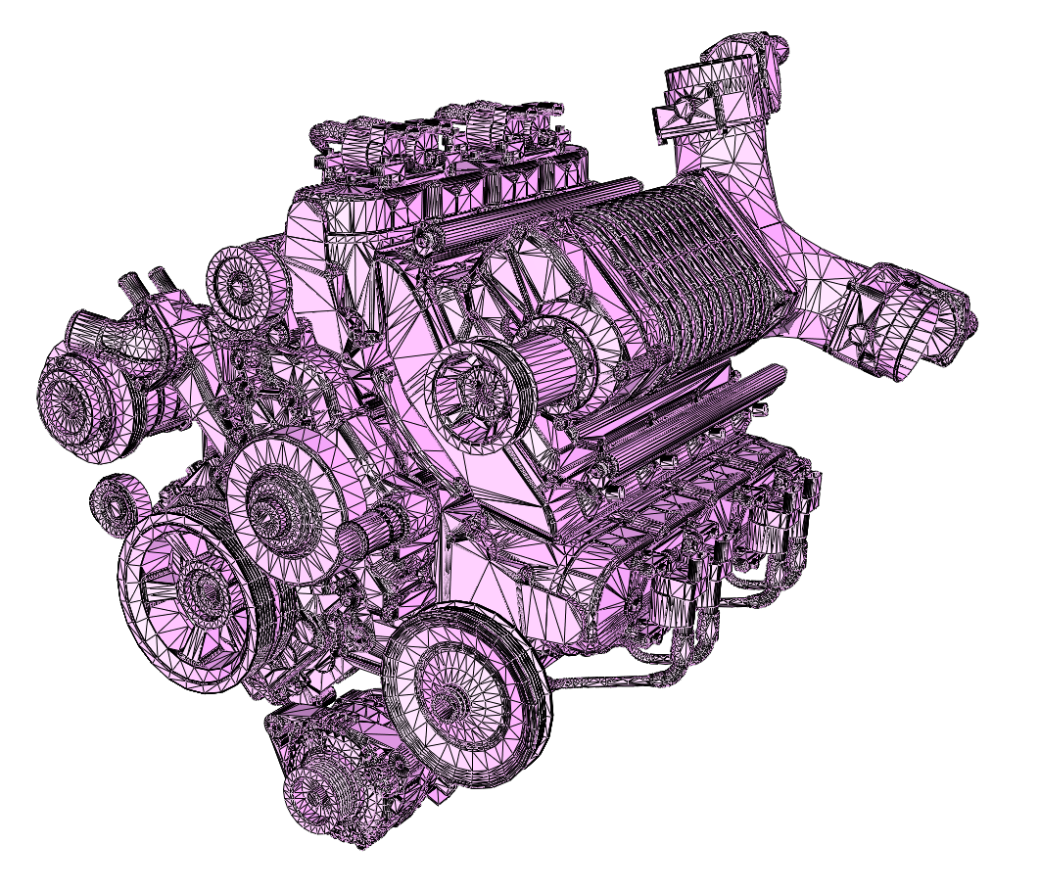
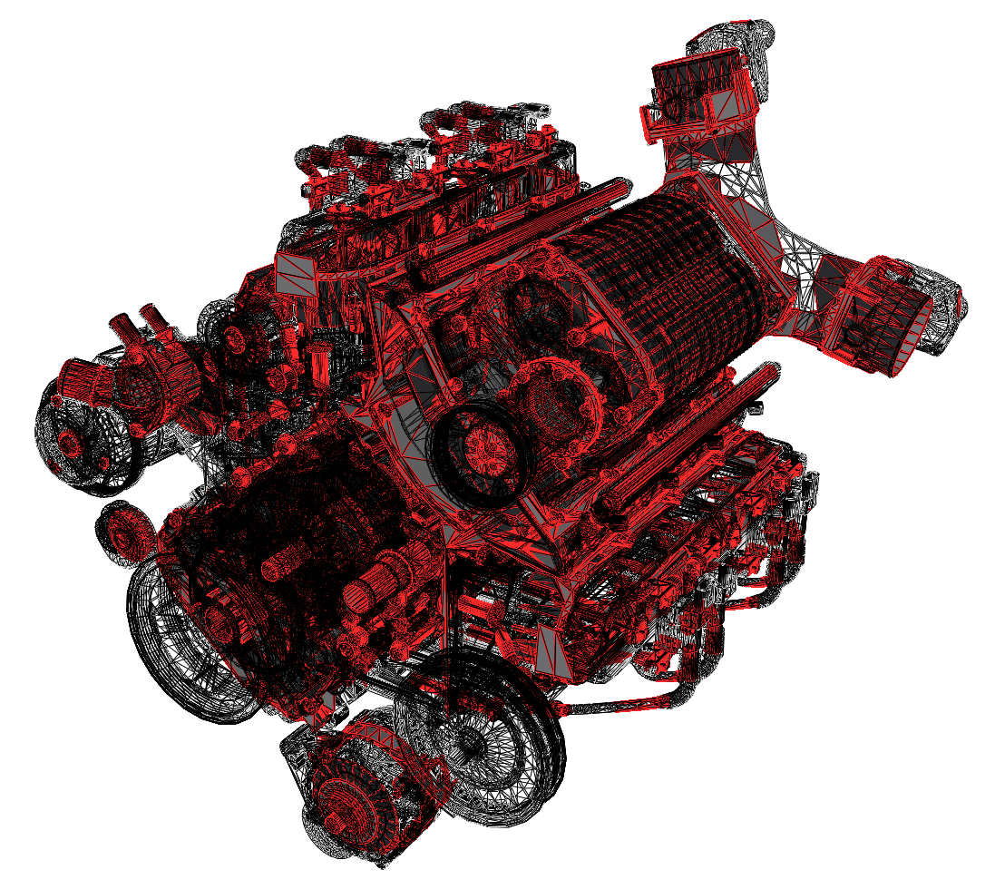
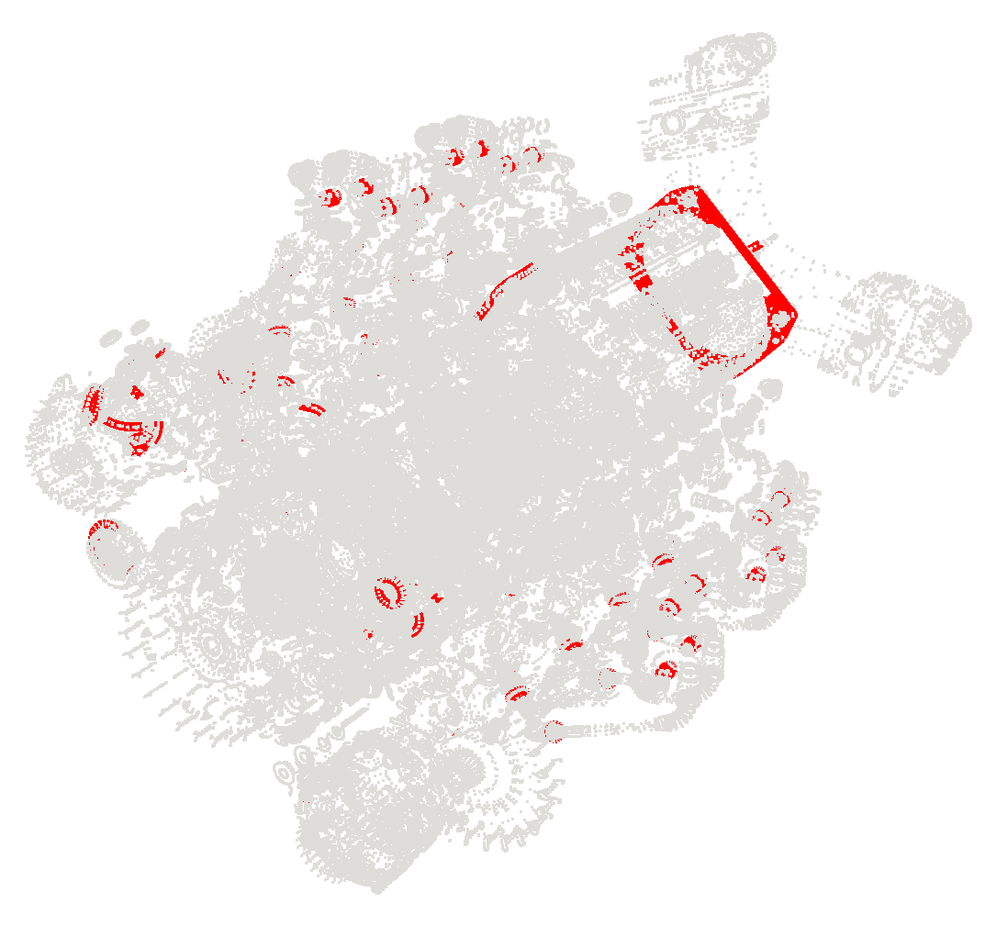
Motivation: mesh validity
Many 3D MODELS ARE NOT VALID meshes
Input Chevy engine [GrabCAD]
Self-intersections
Complex inner structures
Non-manifold structures
Spurious boundaries
Notes:
Self-intersections, non-manifoldness & spurious boundaries, complex inner structures.

Slide 4
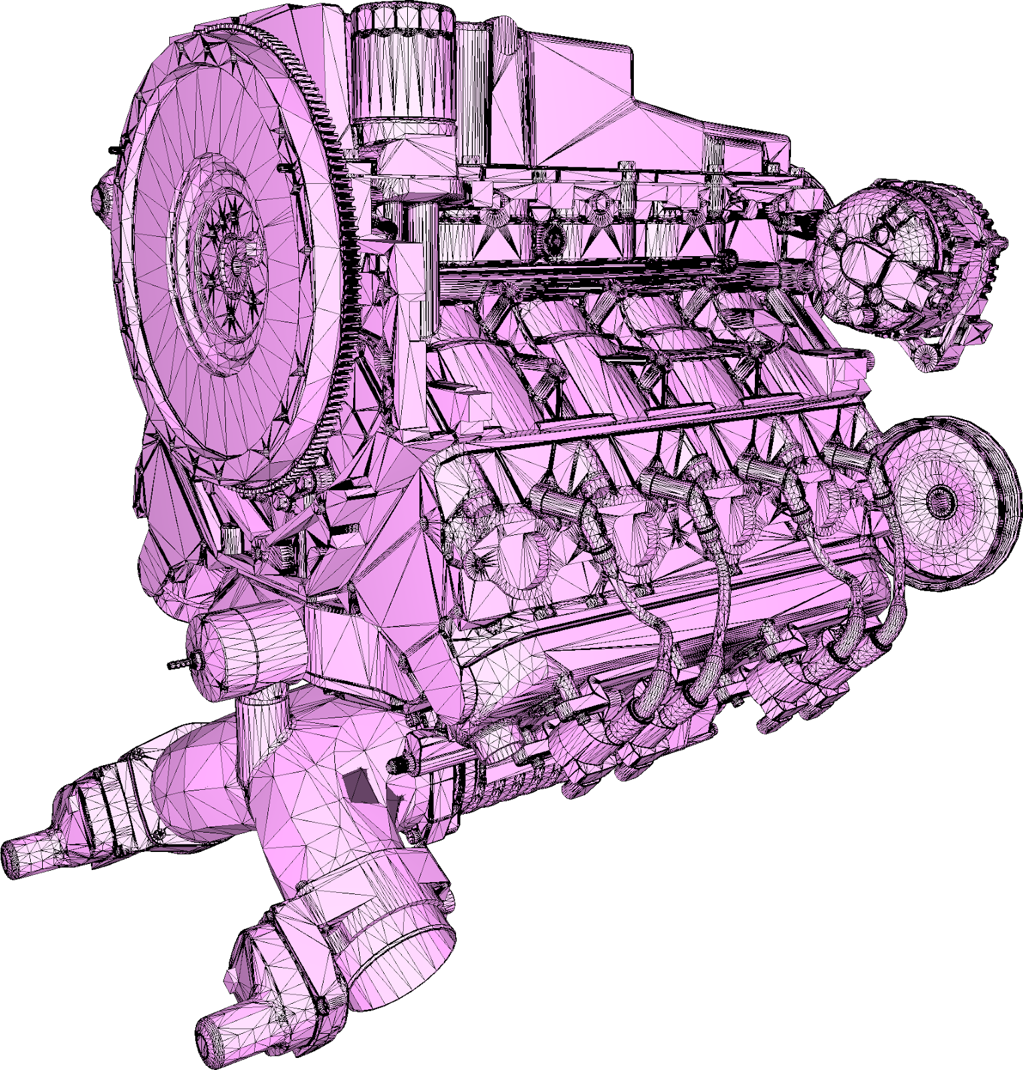
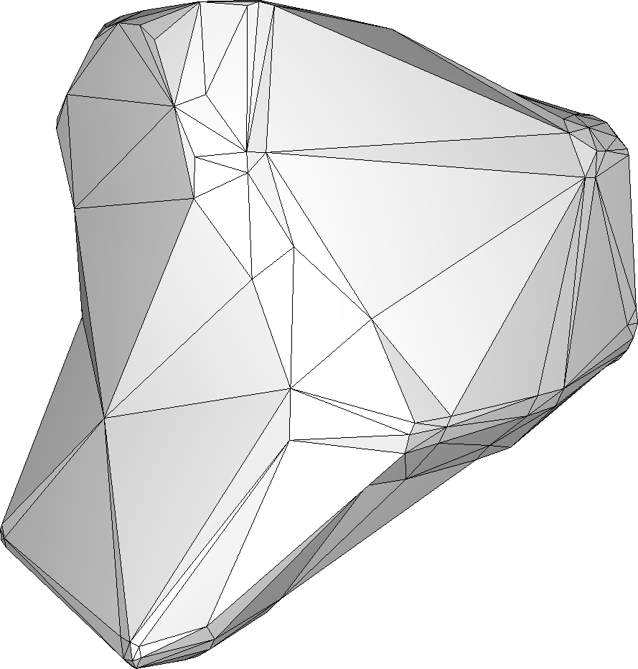
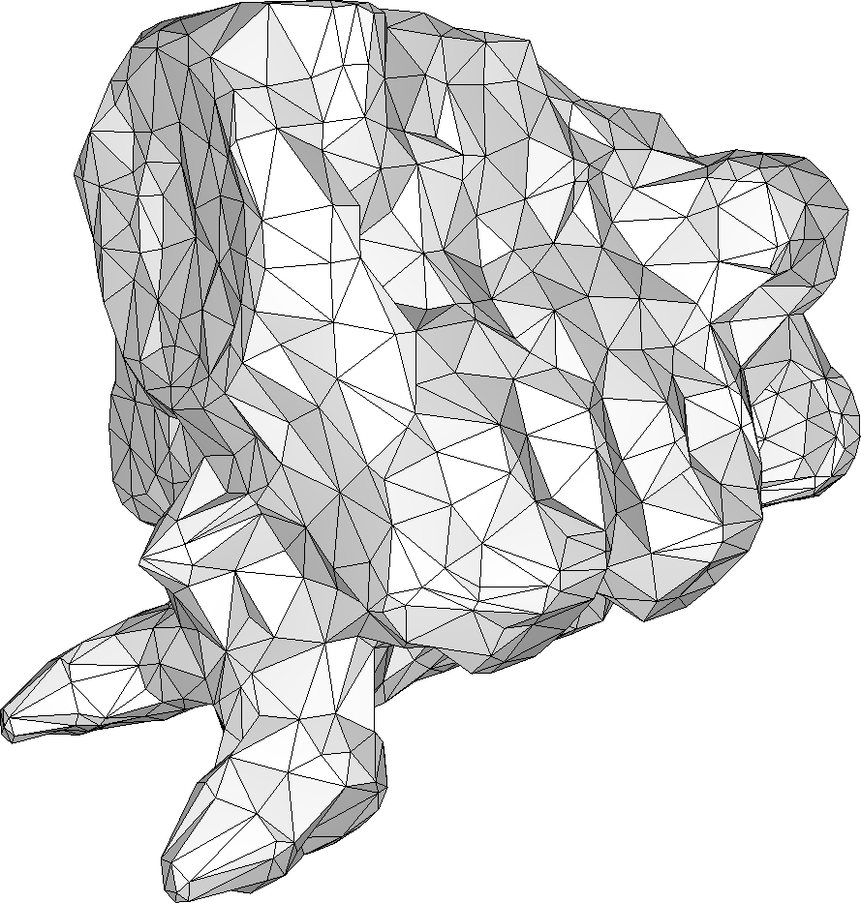
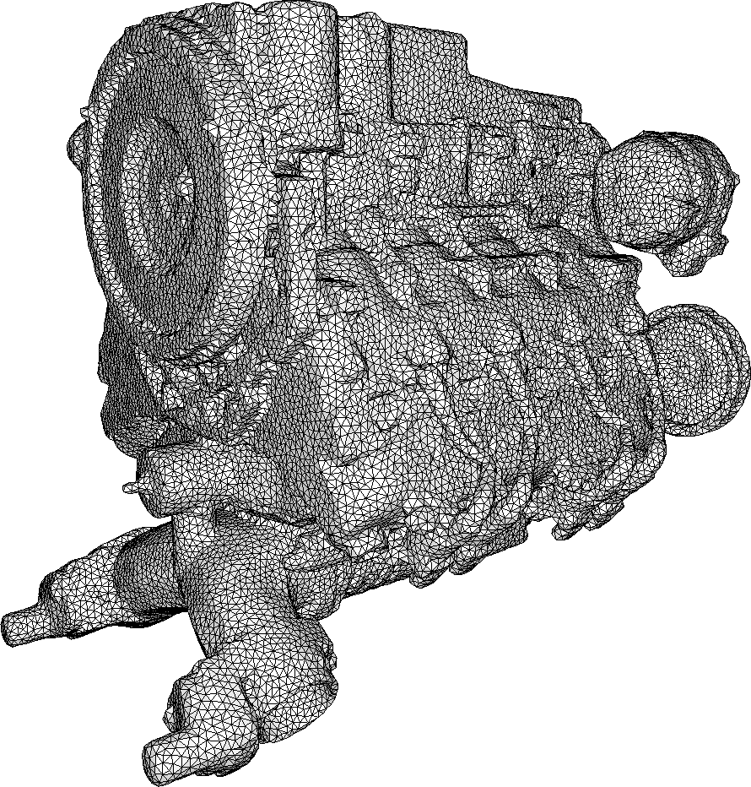
Problem statement
Input
3D model, possibly with defects
DESIRED Output: a Wrap
Watertight, manifold triangle mesh
No self-intersections
Enclosing the input
Algorithm properties:
Ignore inner structures
Controllable complexity of output
Robustness to input defects
Notes:
In particular, we wish to have a way to control the complexity of the output

Slide 5
Approach
Notes:
Voice: Our approach bridges the gap between a number of existing approaches by combining alpha shapes, mesh carving, and Delaunay-based meshing.

Slide 6
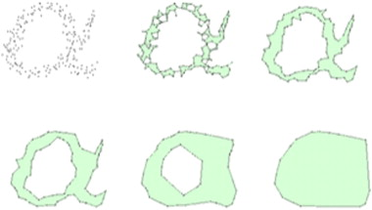
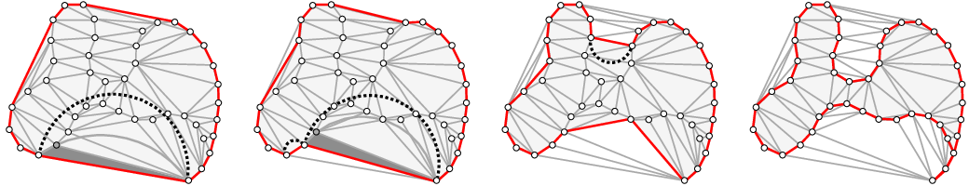
Alpha shapes & carving
Alpha shapes [Edelsbrunner-MÜCKE 94]
Requires sampling of whole input
Does not strictly enclose input
Delaunay carving [Boissonnat 84, Bernardini-Bajaj 97, Giesen 02, Edelsbrunner 03, Allegre 05]
Requires sampling of whole input
Creates non-manifoldness
Allegre 05
Notes:
Voice: We quickly recall these notions: the alpha shape is a generalization of the notion of convex hull. A visual analogy of this structure is to think of the ambient space as ice cream and the input points as chocolate pieces. The result of carving the ice-cream with a spherical spoon of radius 𝛼 is an intuitive description of the so-called alpha shape.
Delaunay carving is a similar concept. However, these two classes have a number of strong downsides, mainly a sampling of the full domain is required, and the result is not necessarily manifold.

Slide 7
Algorithm overview
Start from a bounding box
Alternate two atomic operations:
Carving: get close to the input
Delaunay refinement: enable getting closer to the input
Maintain a valid boundary at all times
Notes:
Voice: To create these points on the offset surface, we use an ambient 3D Delaunay triangulation and alternate carving and Delaunay refinement.

Slide 8
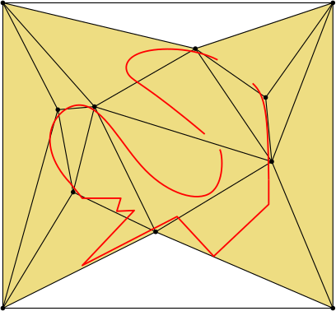
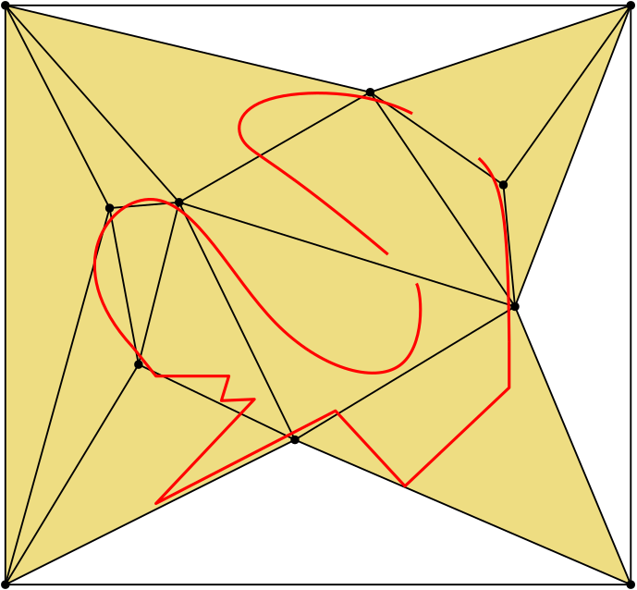
CARVING
Notes:
Voice: To create these points on the offset surface, we use an ambient 3D Delaunay triangulation and alternate carving and Delaunay refinement.

Slide 9
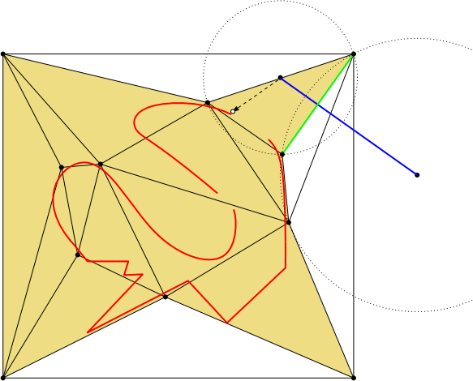
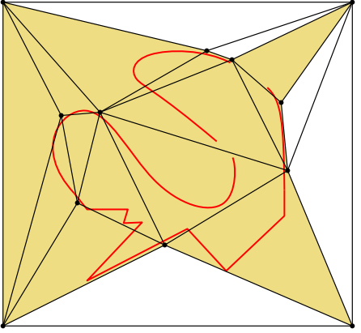
REFINEMENT
Notes:
Voice: To create these points on the offset surface, we use an ambient 3D Delaunay triangulation and alternate carving and Delaunay refinement.

Slide 10
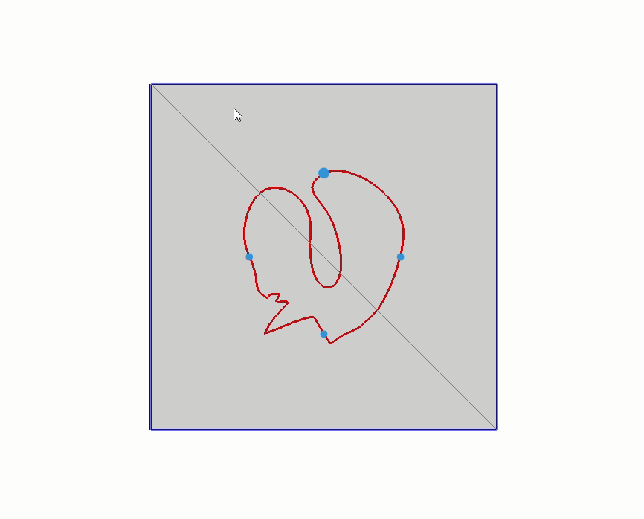
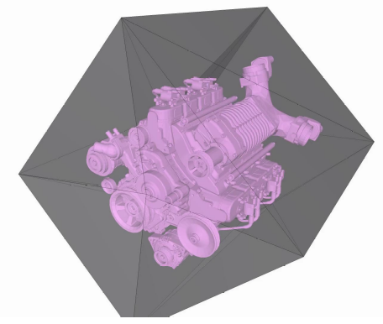
Algorithm illustration in 2D and 3D
Notes:
Voice: Here is an illustration of the algorithm on a simple 2D model

Slide 11
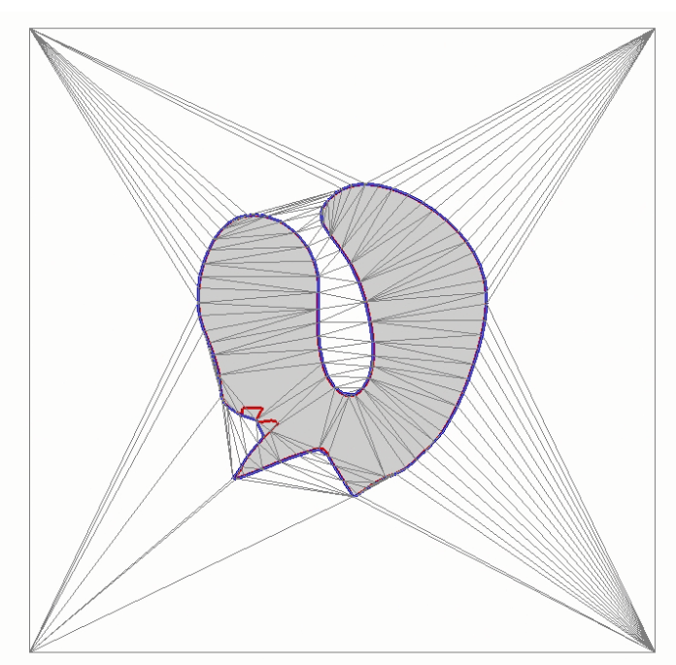
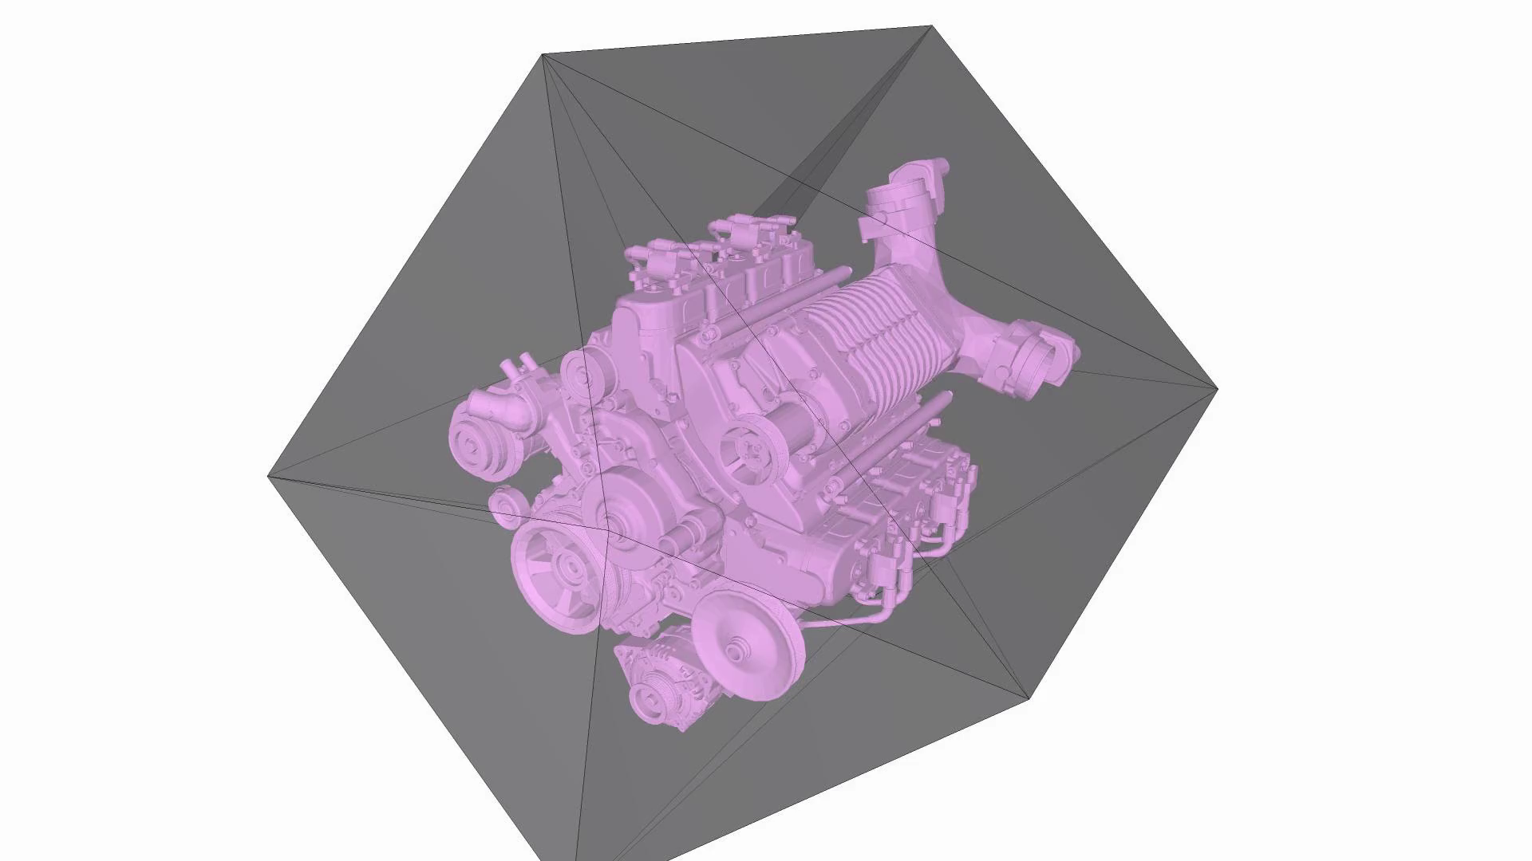
Algorithm illustration in 2D and 3D
Notes:
Voice: Here is an illustration of the algorithm on a simple 2D model

Slide 12
Algorithm illustration in 2D and 3D
Notes:
Voice: Here is an illustration of the algorithm on a simple 2D model

Slide 13
Results
Notes:
Voice: We now present some applications to illustrate the usefulness of our method.

Slide 14
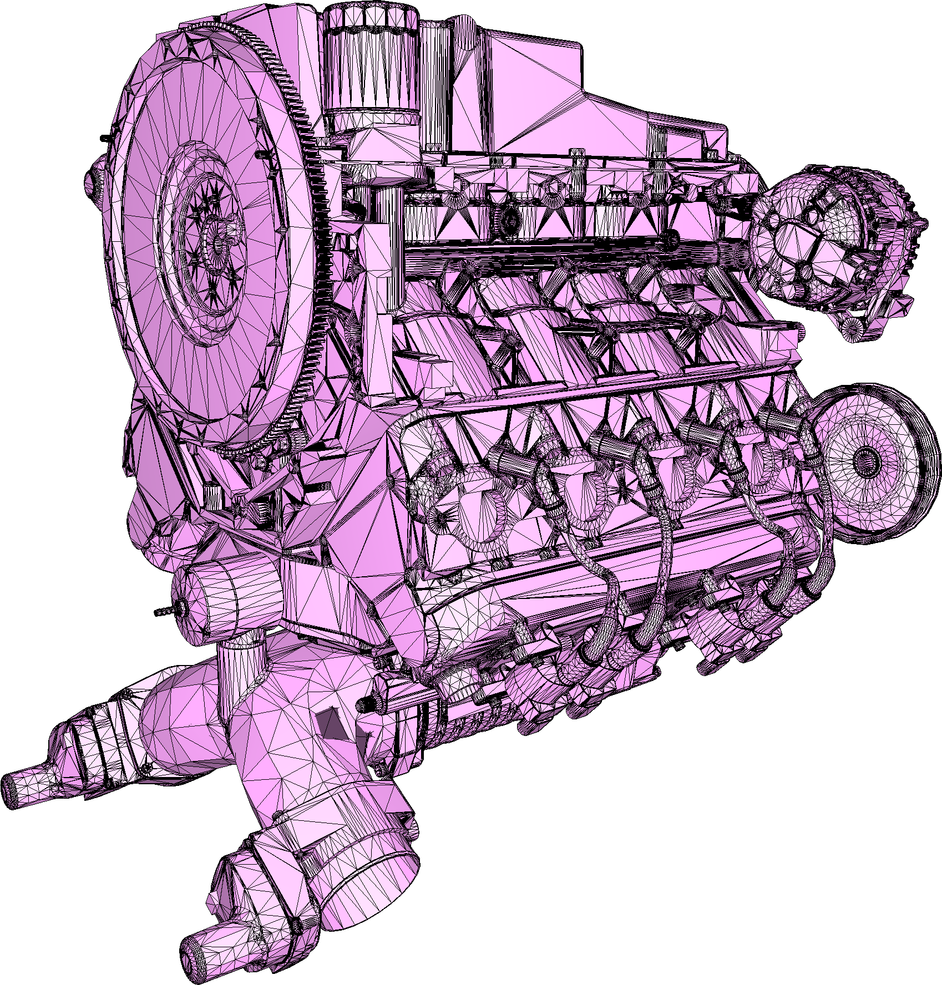
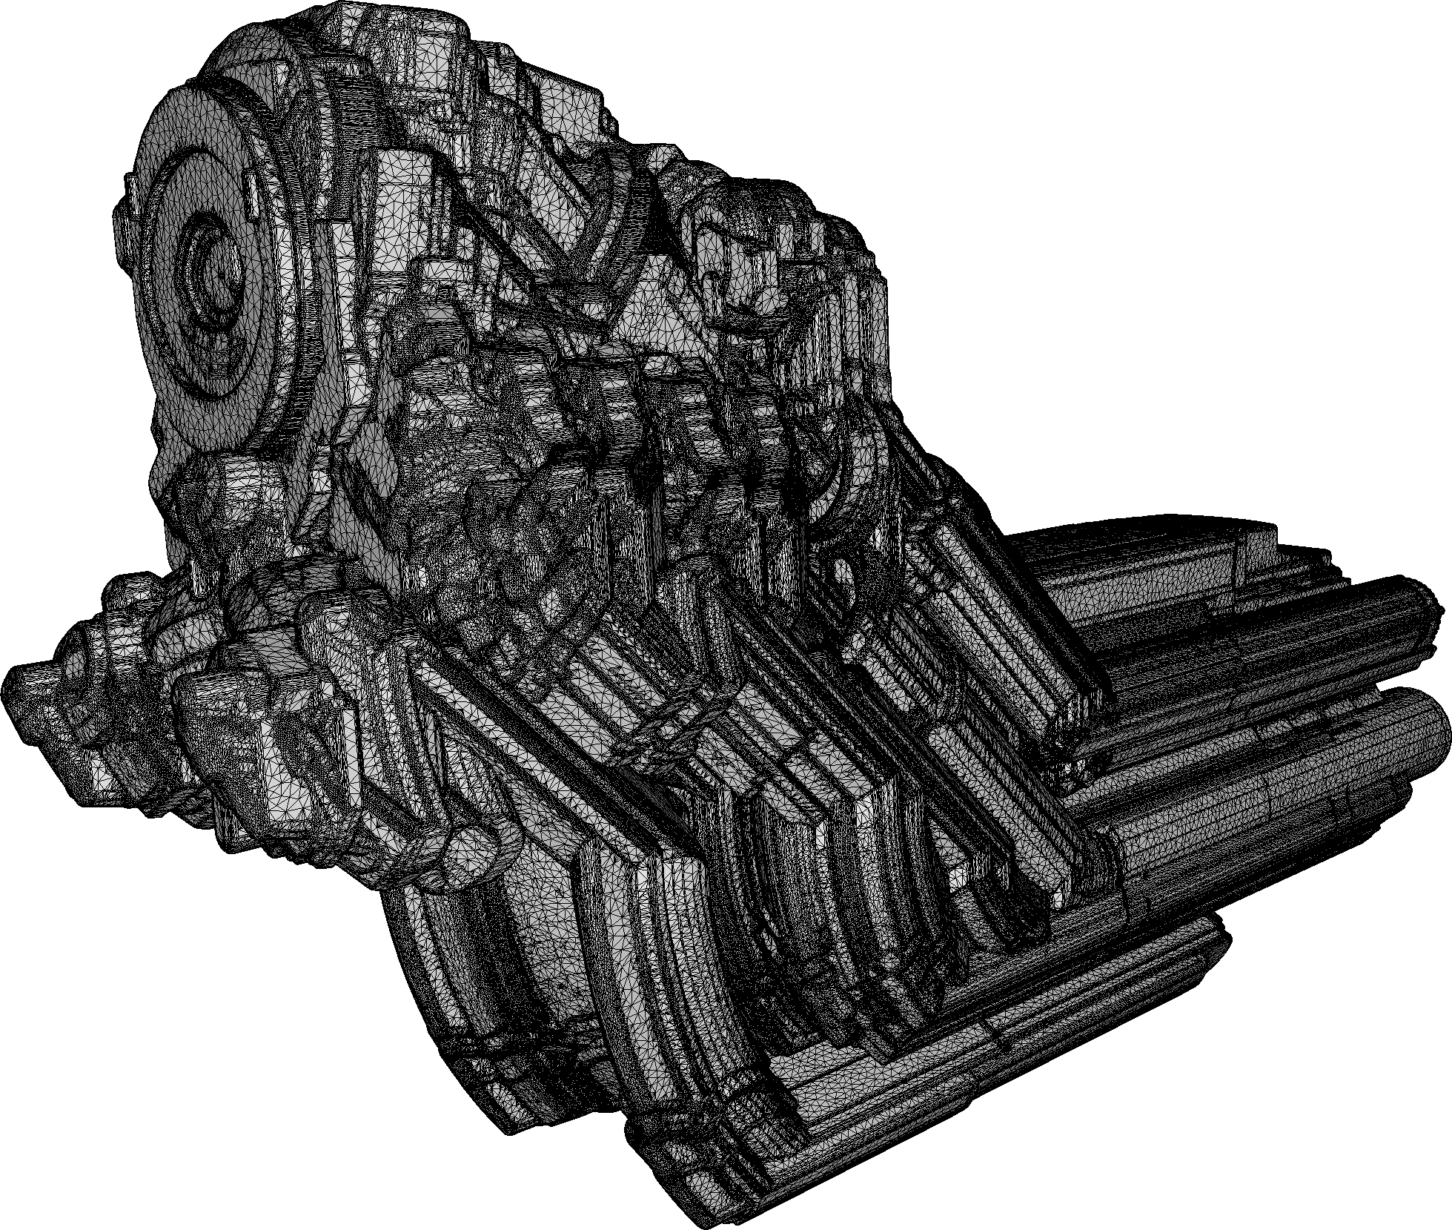
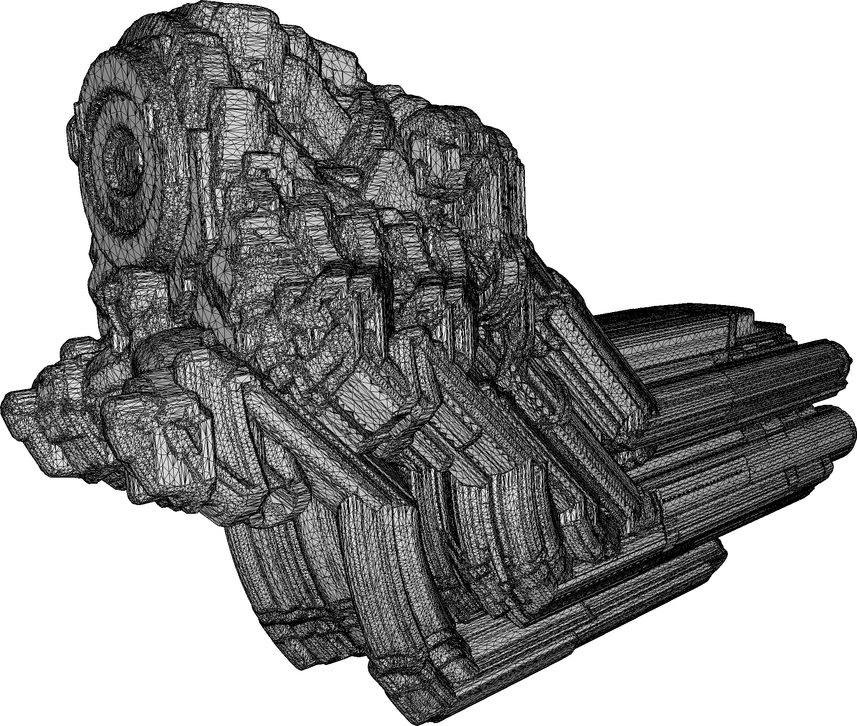
APplication EXAMPLE: swepT volumes
Input:
Complex mesh
Inner structures
All kinds of defects
914s
1.7M facets
Output:
Lower mesh complexity
Valid mesh with no internal elements
Faster sweeping
Conservative and tight w.r.t. to exact sweep
242s
57k facets
Swept volumes by [RMAGS GmbH]
Notes:
Voice: Our method can also be used as a preprocessing step before sweeping, drastically reducing runtime.

Slide 15
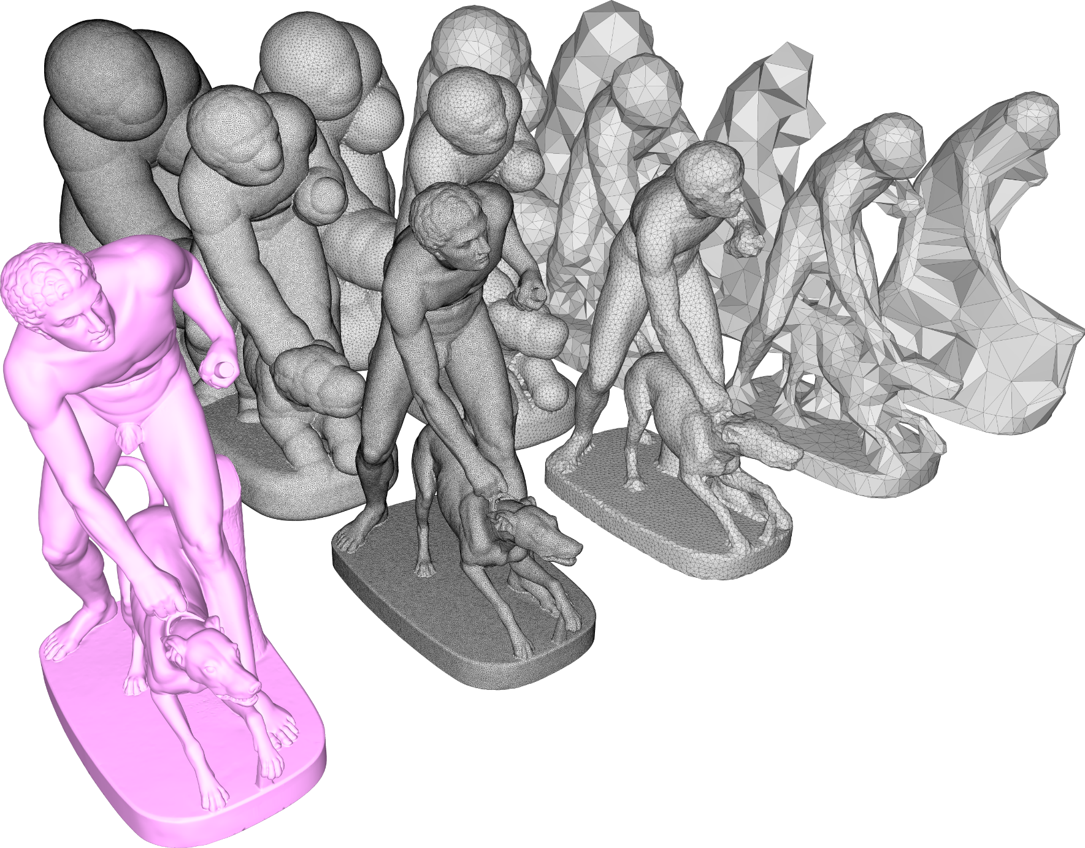
Algorithm parameters
Alpha
Controls diameter of cavities to be explored
Acts as sizing field
Can be arbitrarily large or small
Offset
Guarantee closed 2-manifold mesh
Can also act as a defeaturing parameter, at the cost of tightness (similar to [Shewchuk 04])
Can be arbitrarily large or small
offset
alpha
input
Notes:
Voice: The behavior of the offset is similar to that of 𝛼 when it comes to features: small offset values ensure that the mesh is close to the input, and thus that it will capture well its geometry and features; on the other hand, large offset values act as a defeaturing tool.

Slide 16
Strengths
Notes:
Voice: We now expose the strengths of our method.

Slide 17
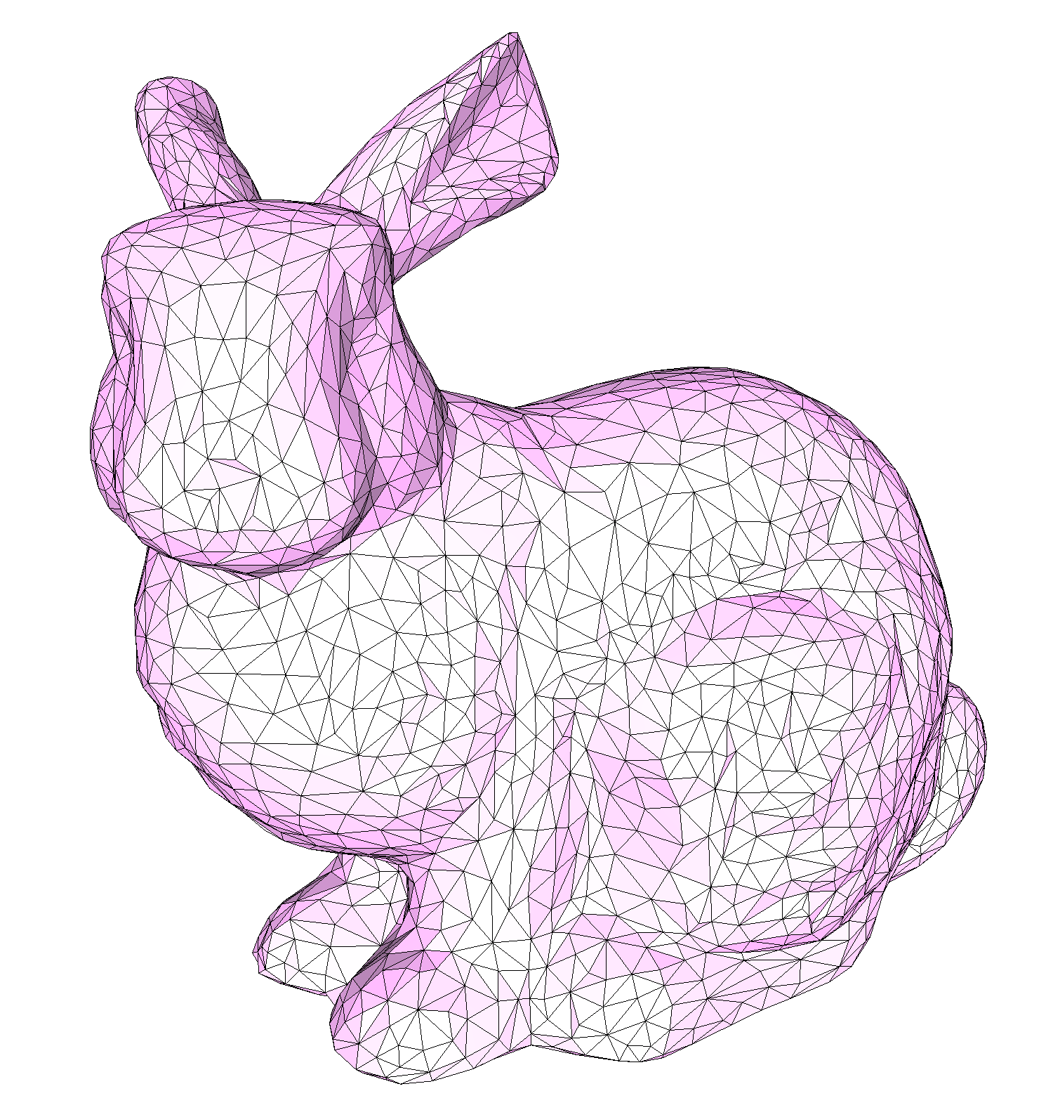
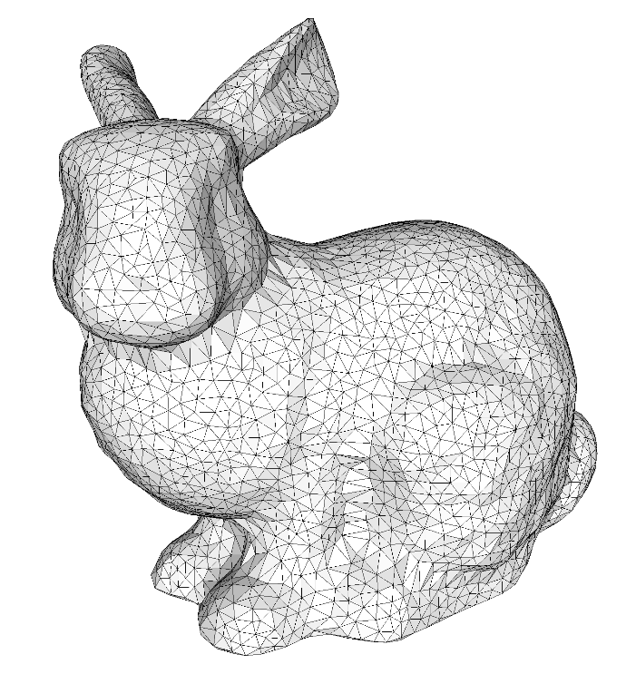
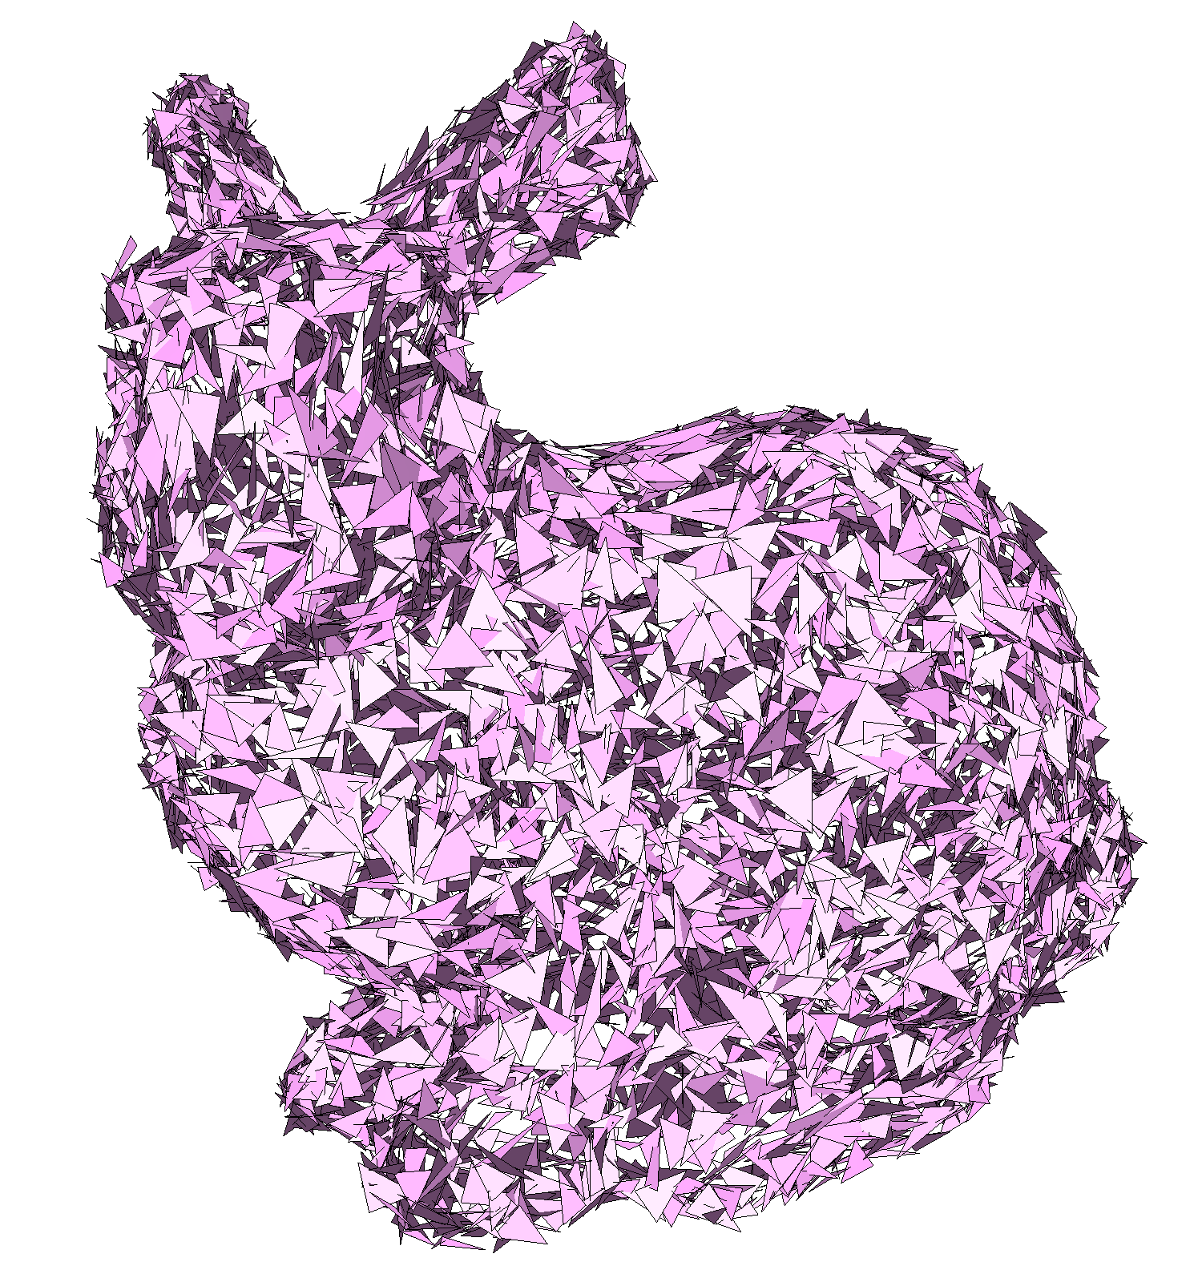
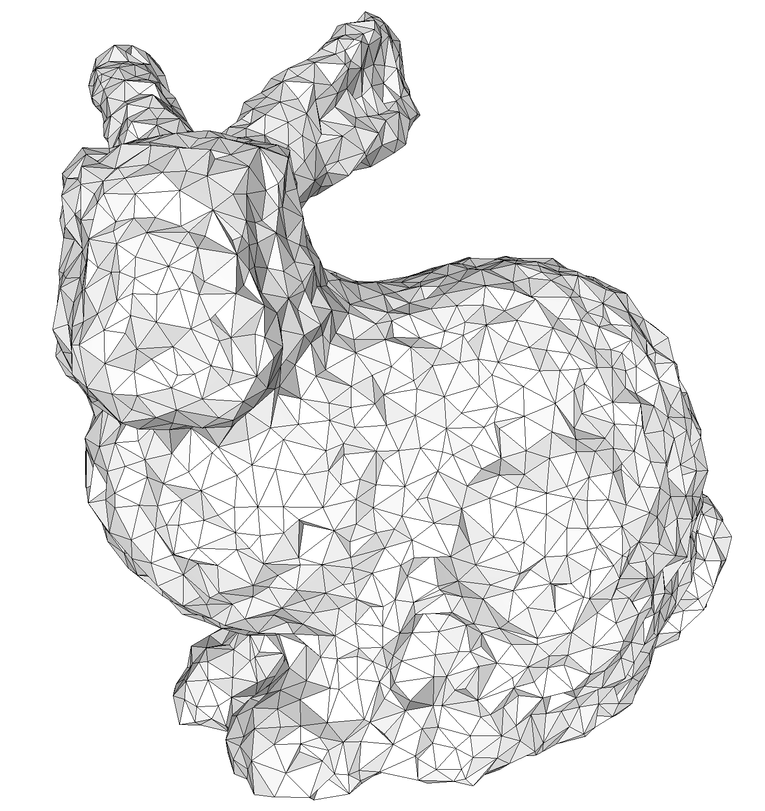
Robustness to defects
Distance field-based approach
Notes:
Thanks to its formulation making only use of an implicit distance function and basic intersection predicates, our algorithm is immune to the usual defects found in many meshes.

Slide 18
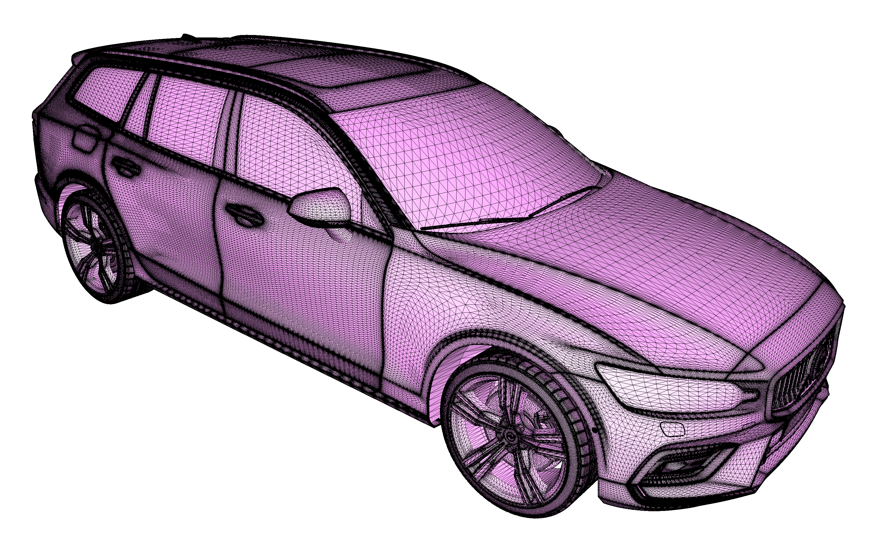
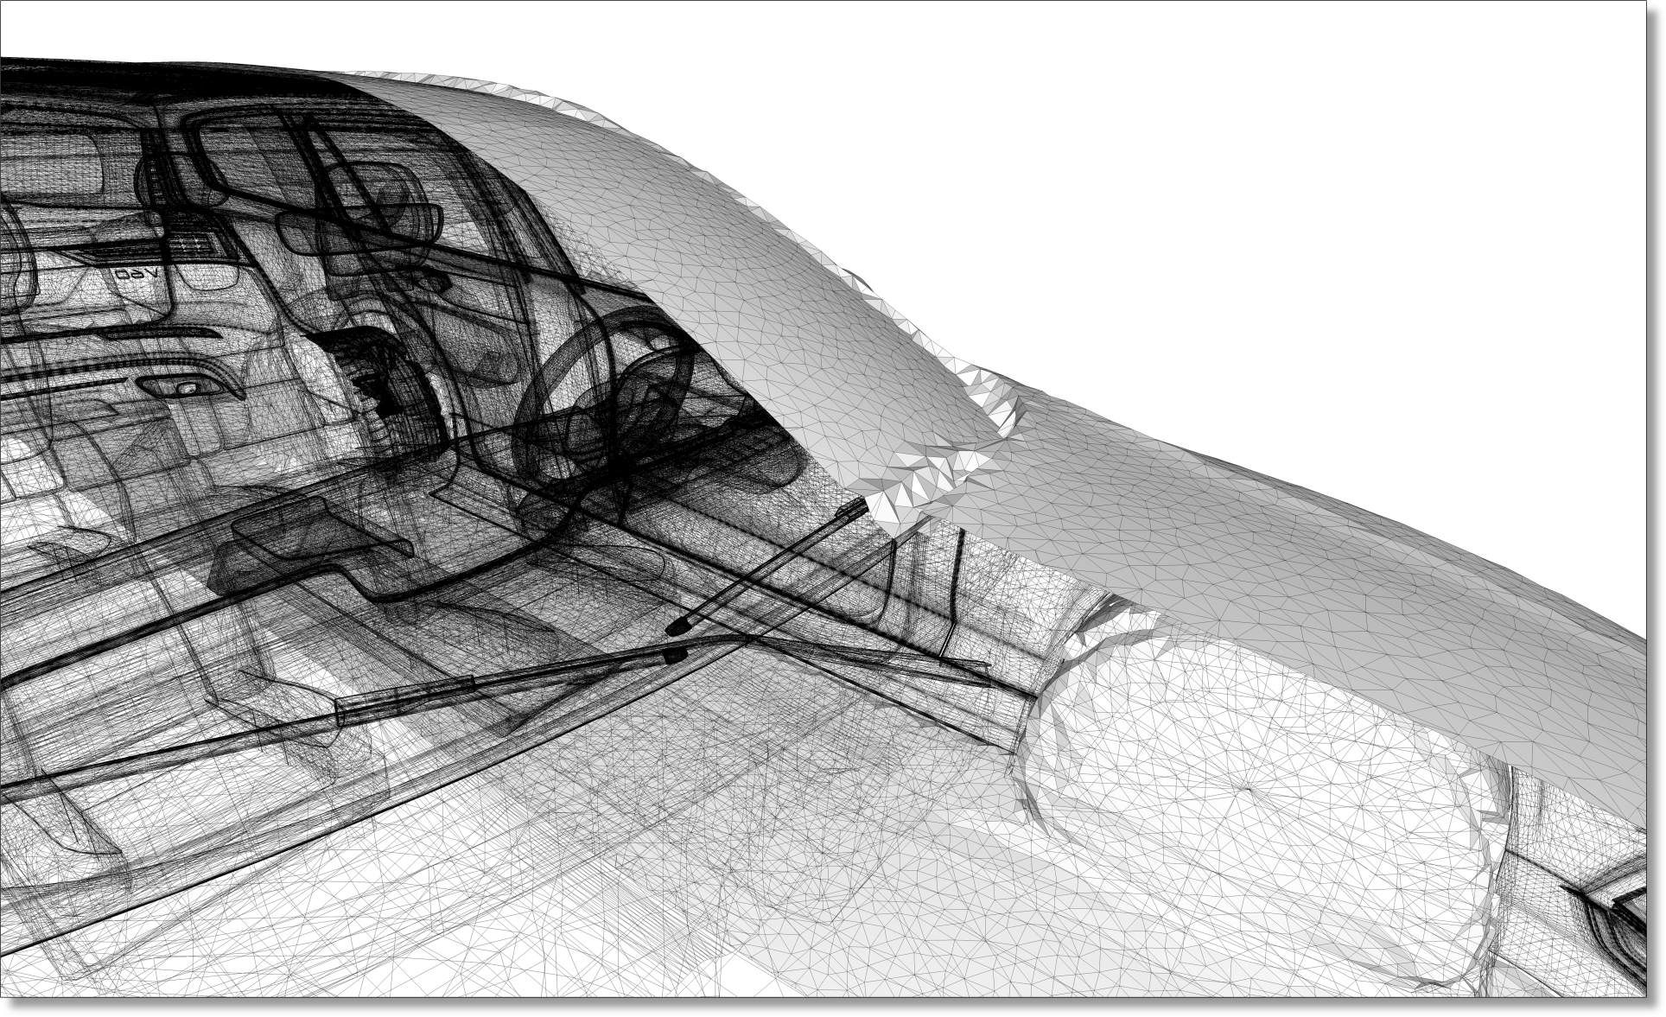
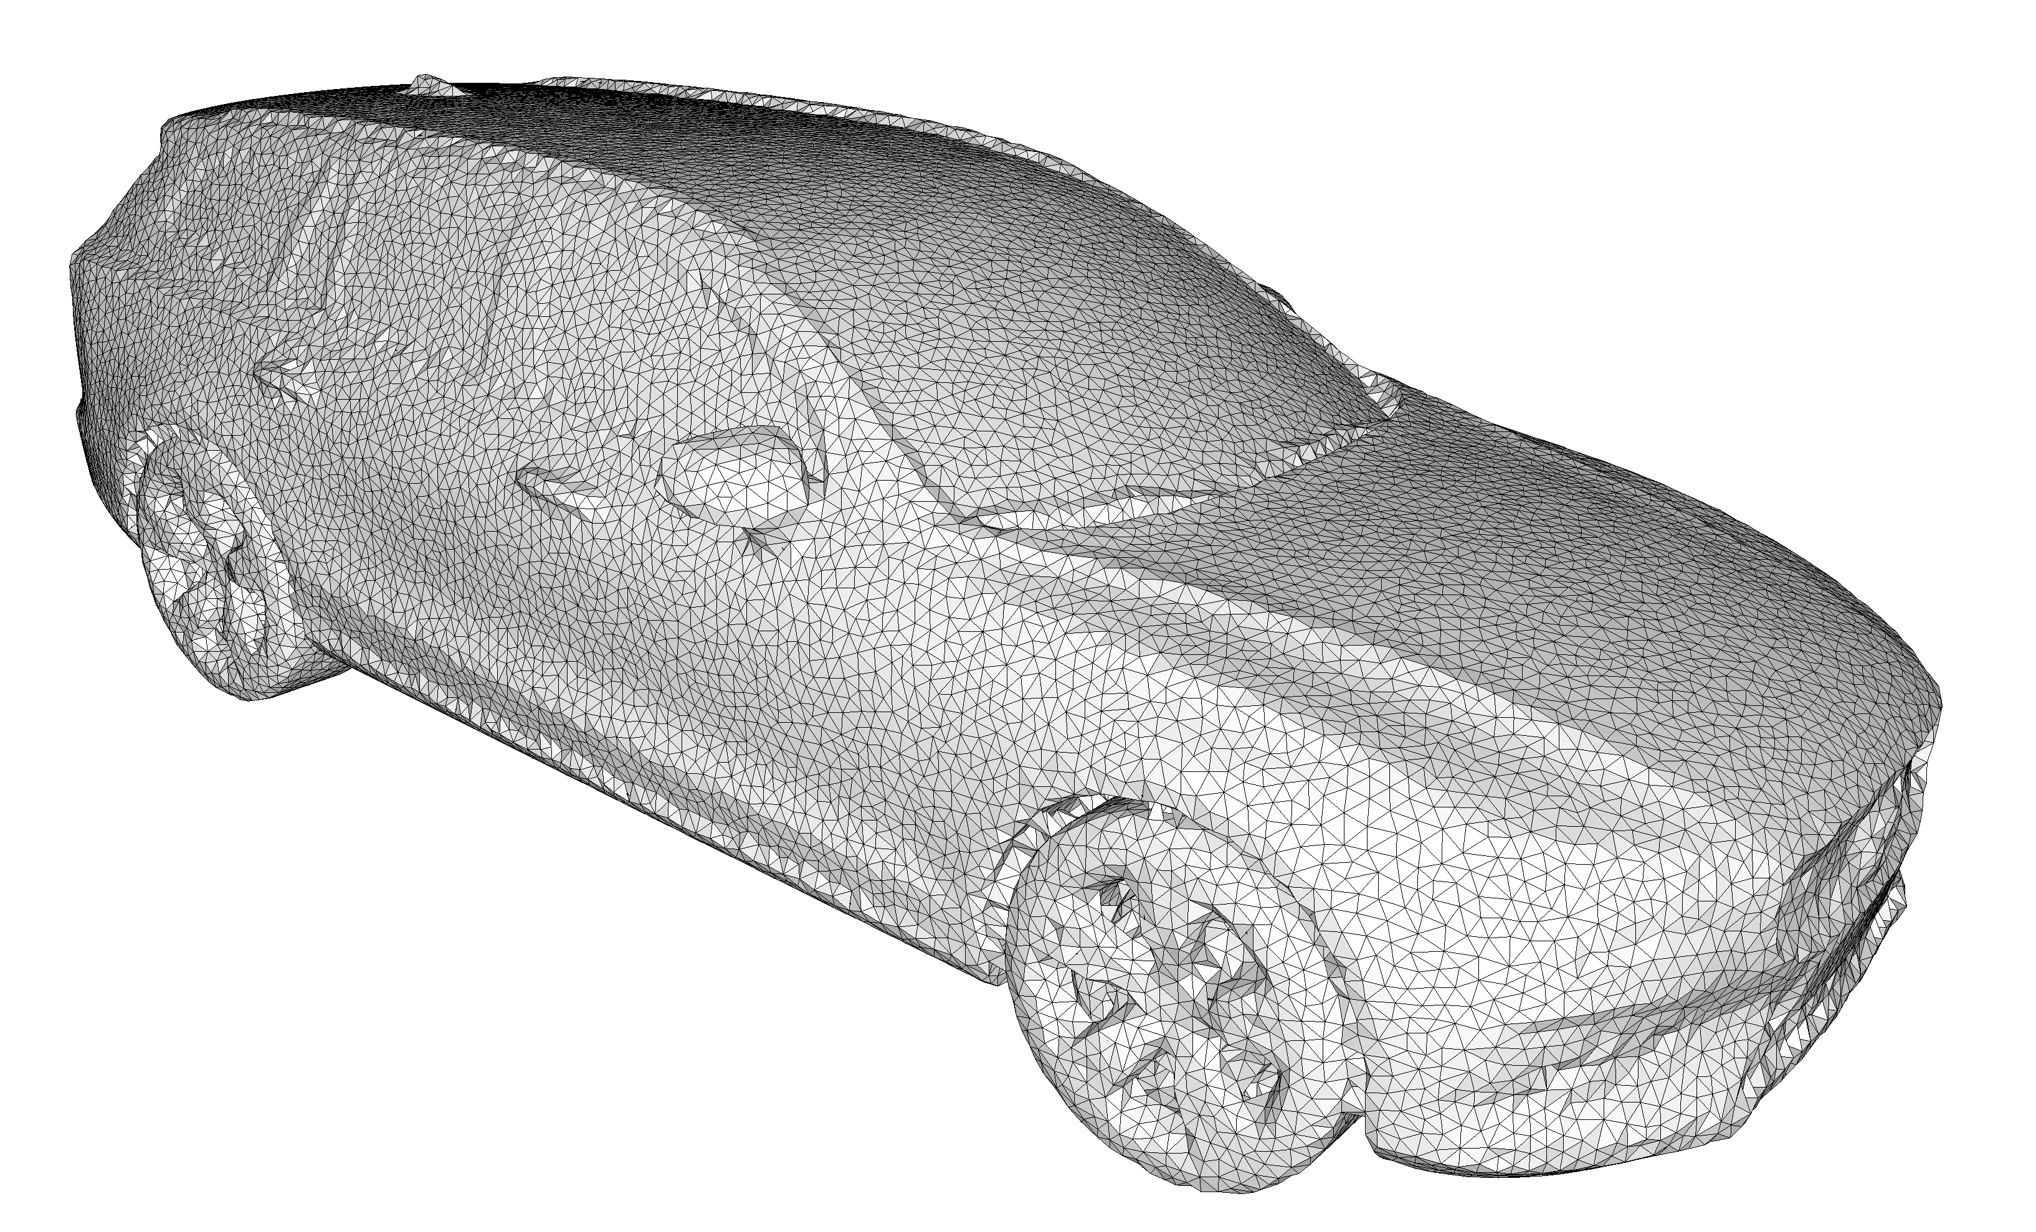
OUTPUT Sensitive COMPLEXITY
Notes:
Voice: The complexity of our algorithm depends primarily on the complexity of the output, meaning that complex inner structures have only a weak influence on the runtime, and no internal sampling is required.

Slide 19
theoretical and EXPERIMENTAL guarantees
Termination
No self-intersections, manifold
Closed, enclosing the input
Bounded one-sided Hausdorff distance (alpha + offset)
Implementation: Code uses CGAL’s efficient exact predicates to ensure that theoretical guarantees are met.
https://www.cgal.org/
Notes:
Voice: Basing our algorithm on extensively studied data structures such as the Delaunay triangulation enabled us to guarantee in theory a number of important properties: termination, validity, input enclosing, and distance bounds.

Slide 20
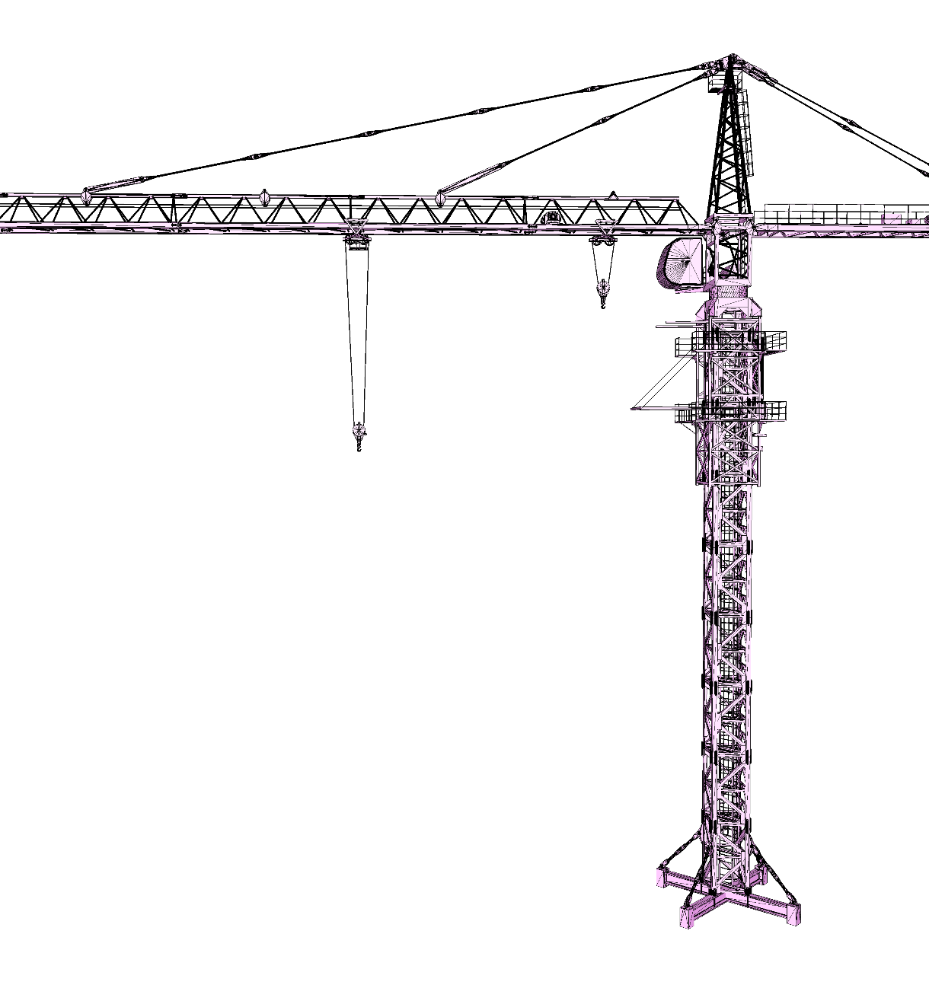
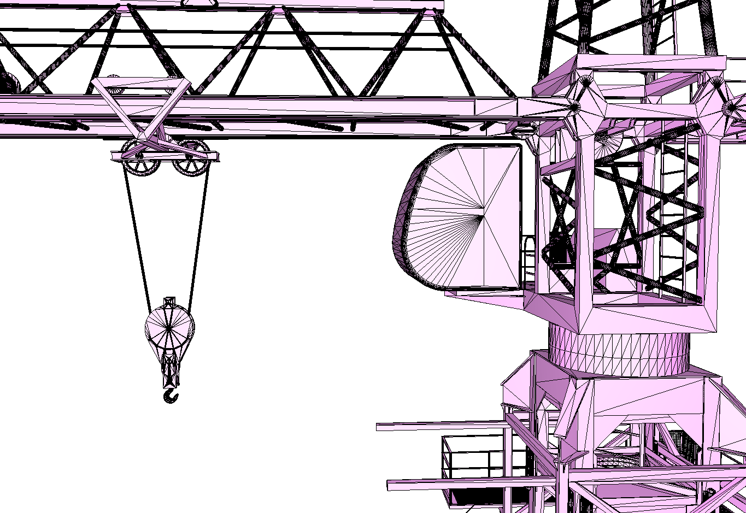
Input (3.5M triangles)

Slide 21
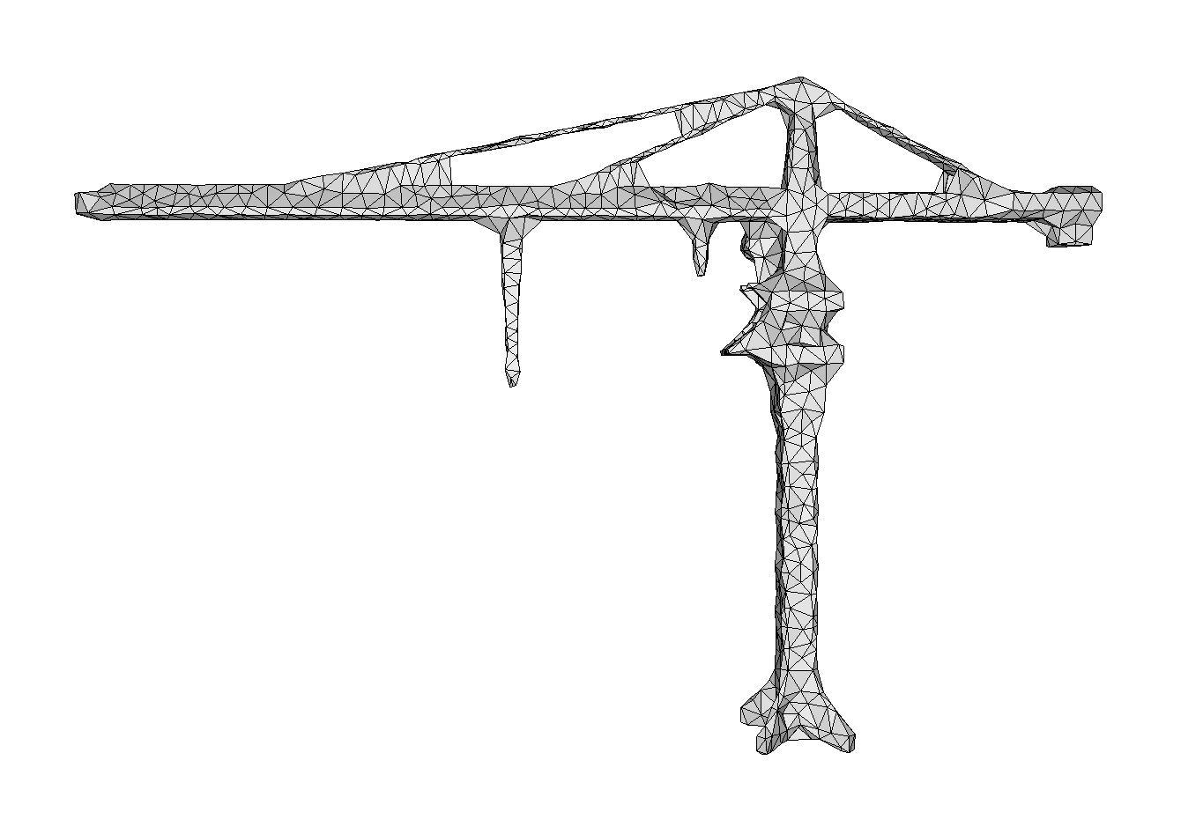
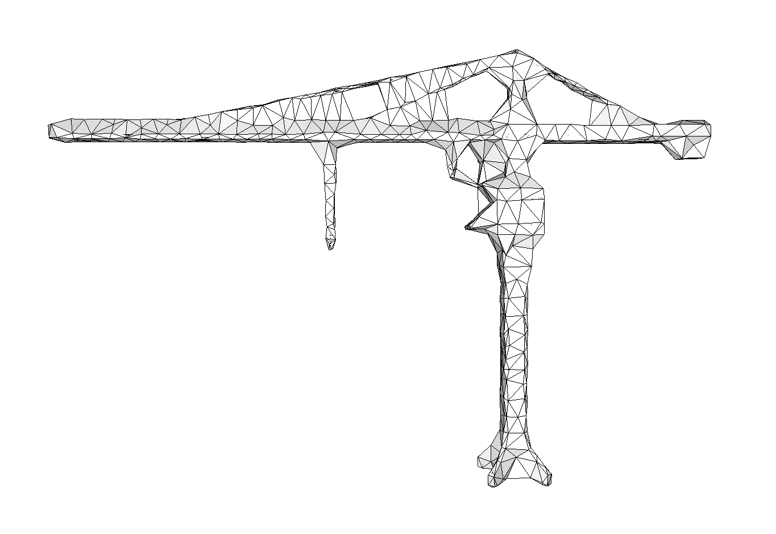
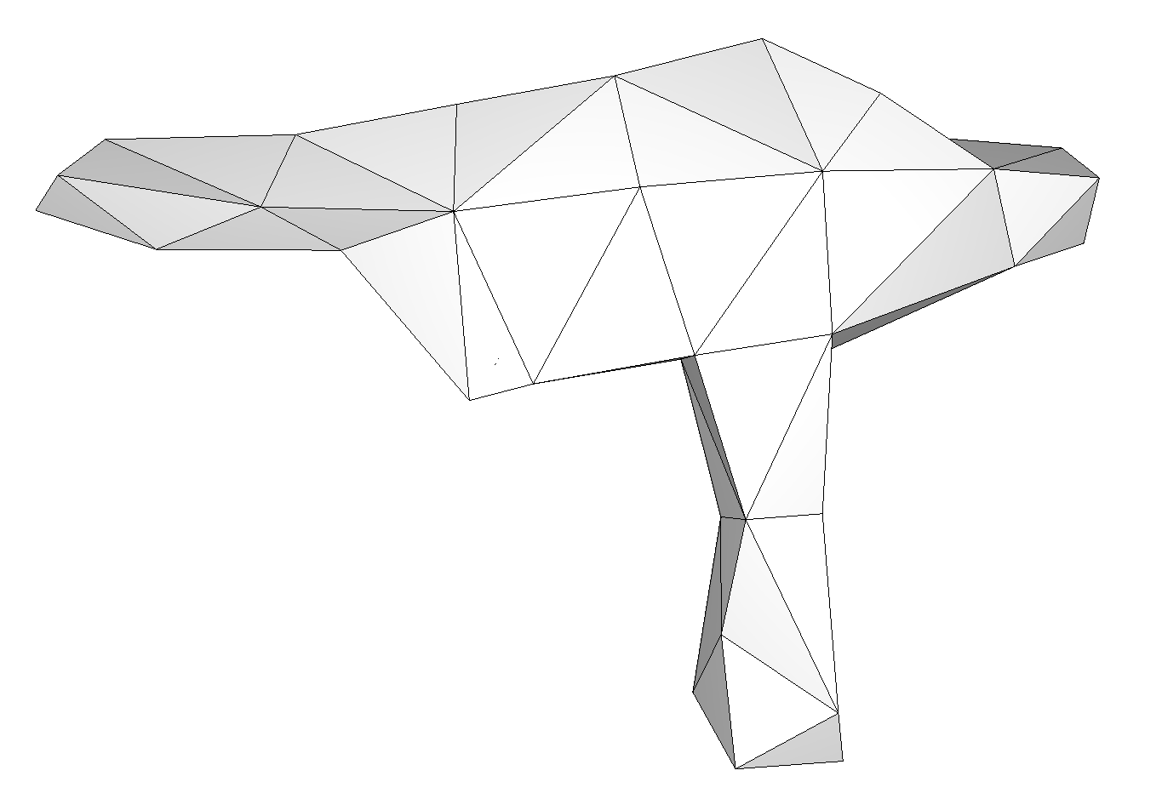
OUTPUT LEVELS of detail

Slide 22
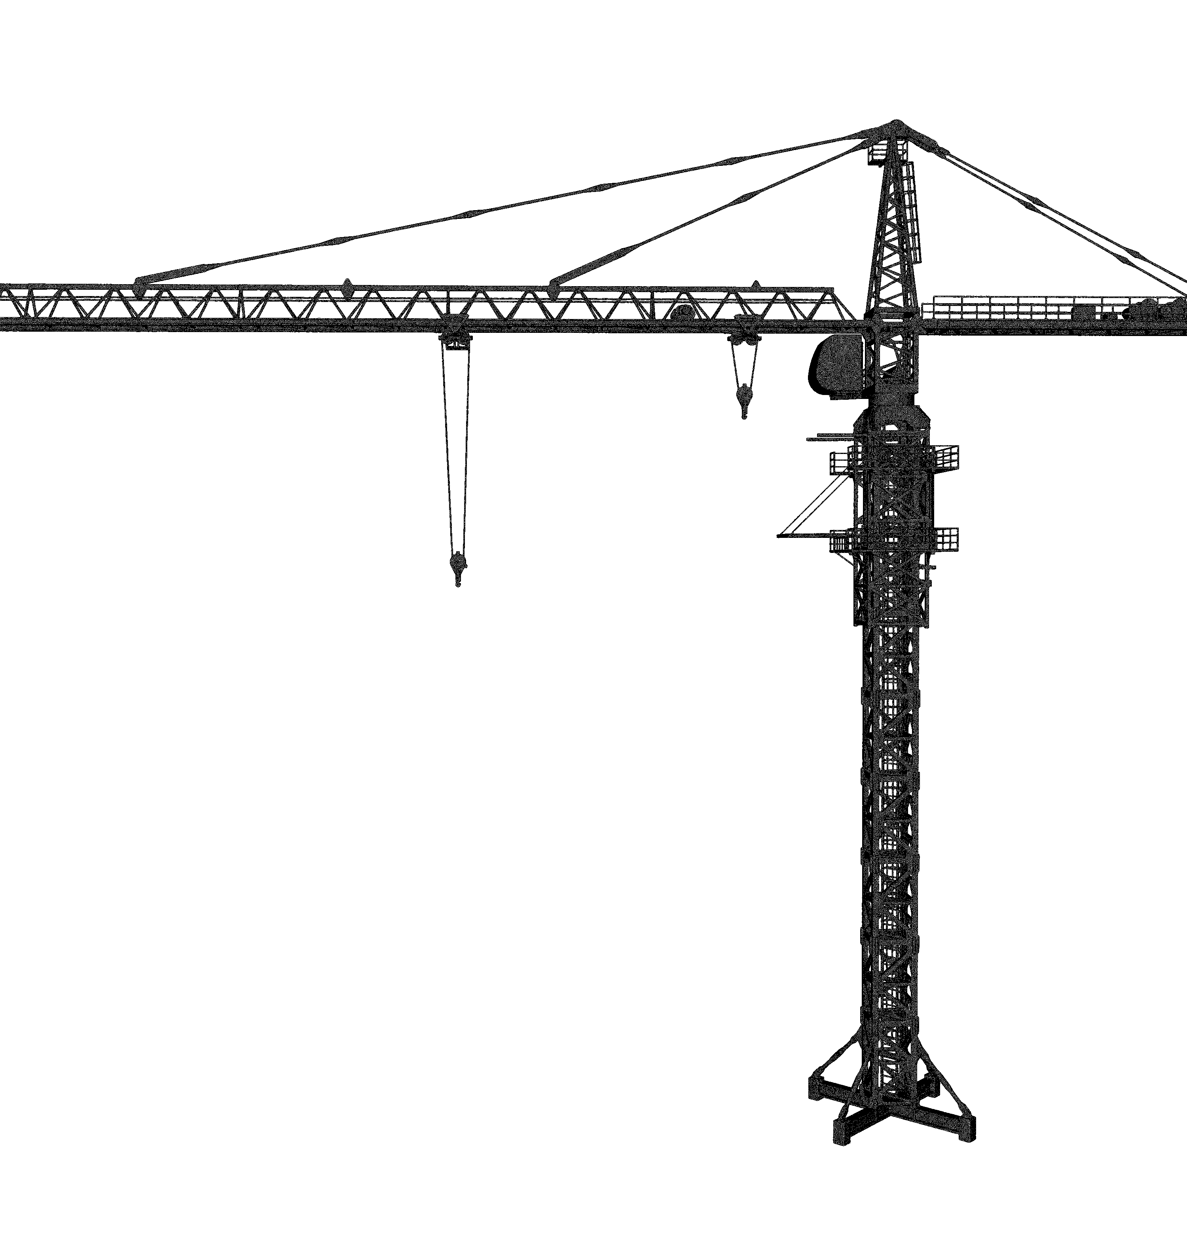
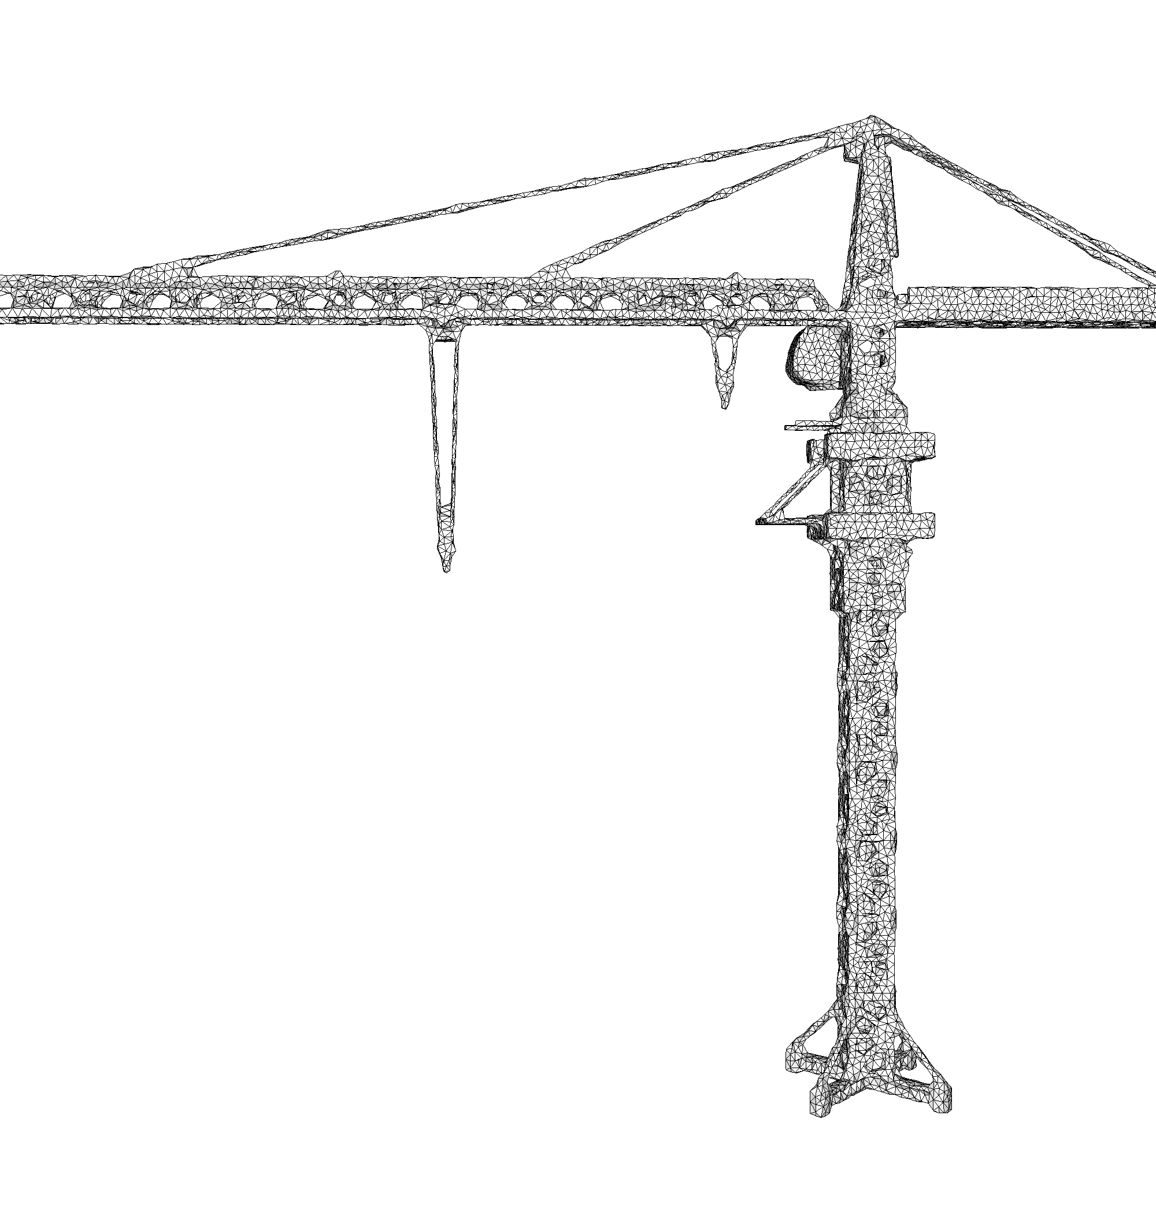
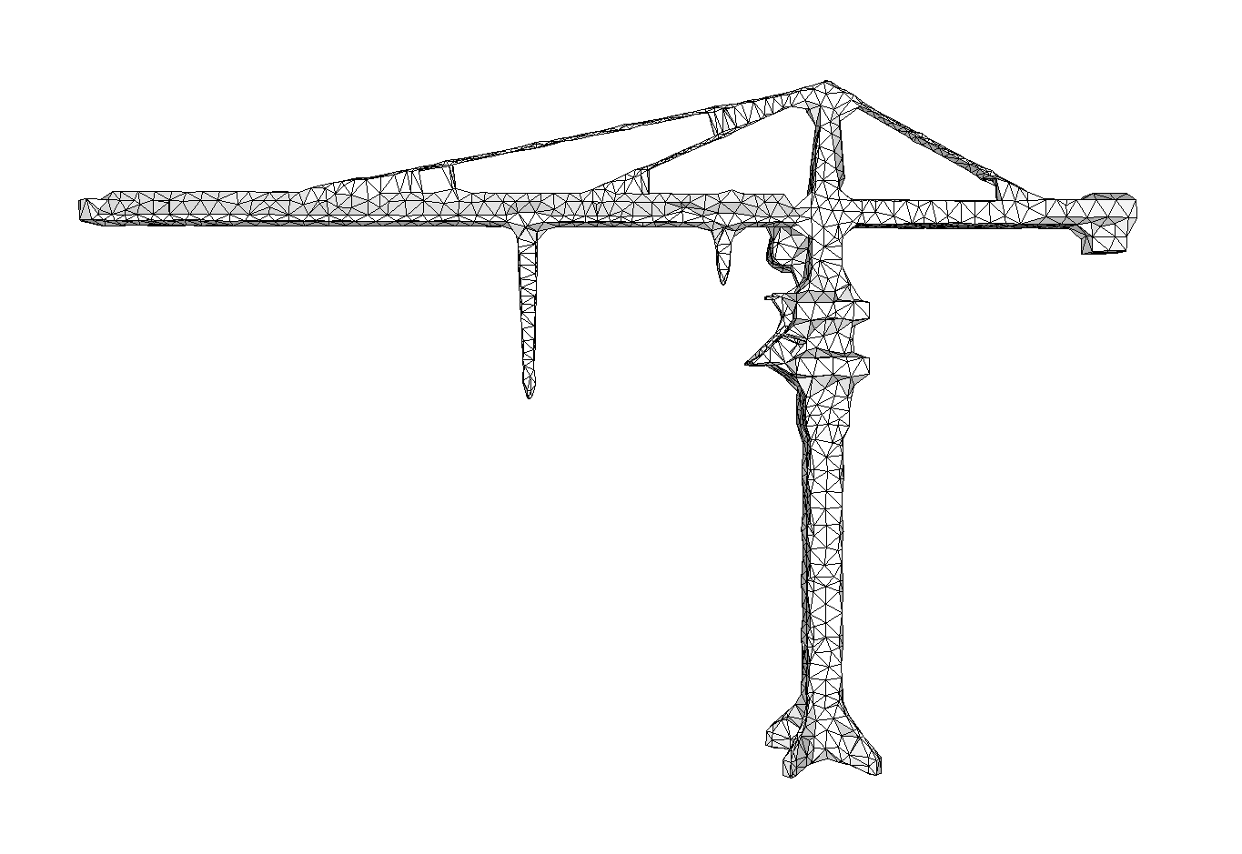
OUTPUT LEVELS of detail (CONT.)

Slide 23
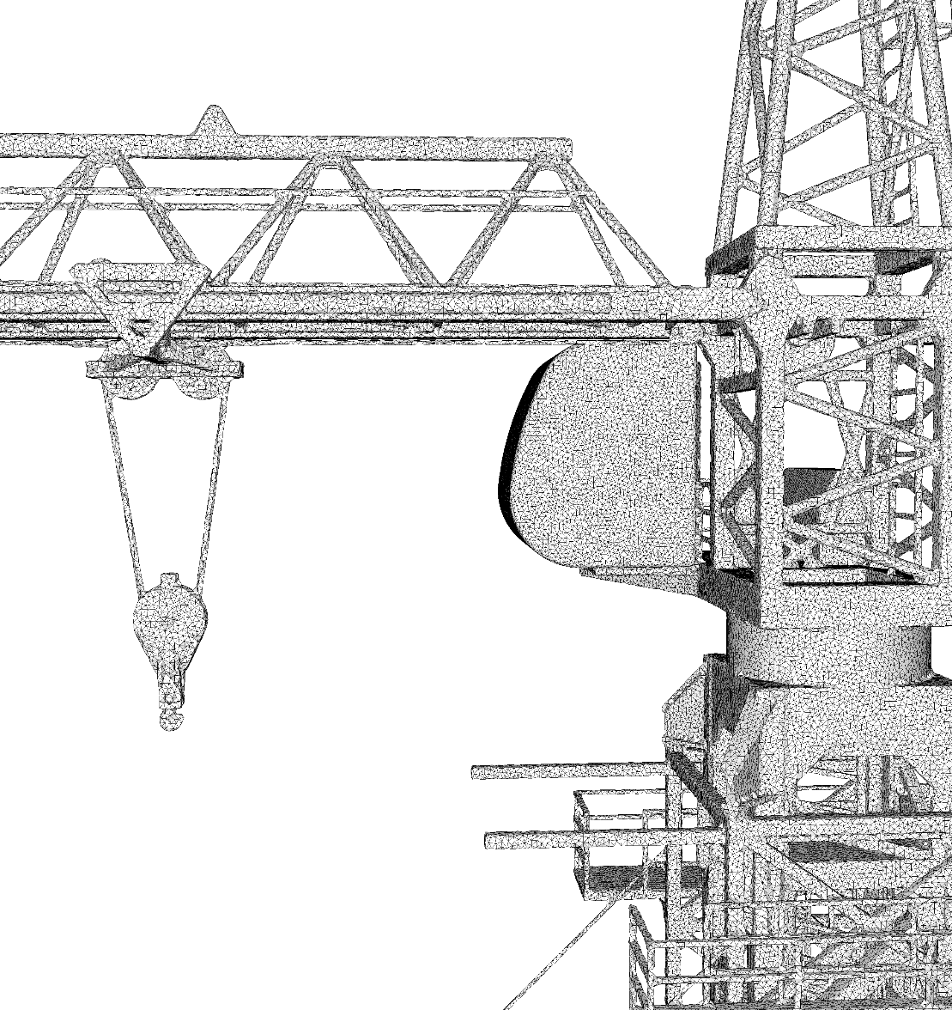
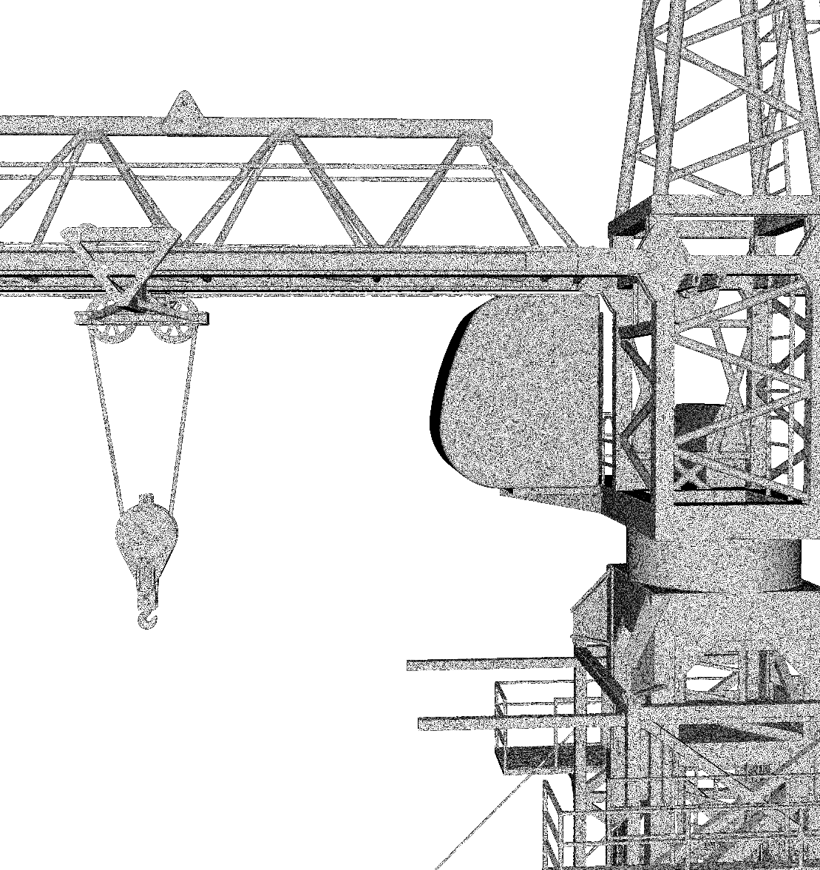
OUTPUT LEVELS of detail (CONT.)
1.2M triangles
7.5M triangles

Slide 24
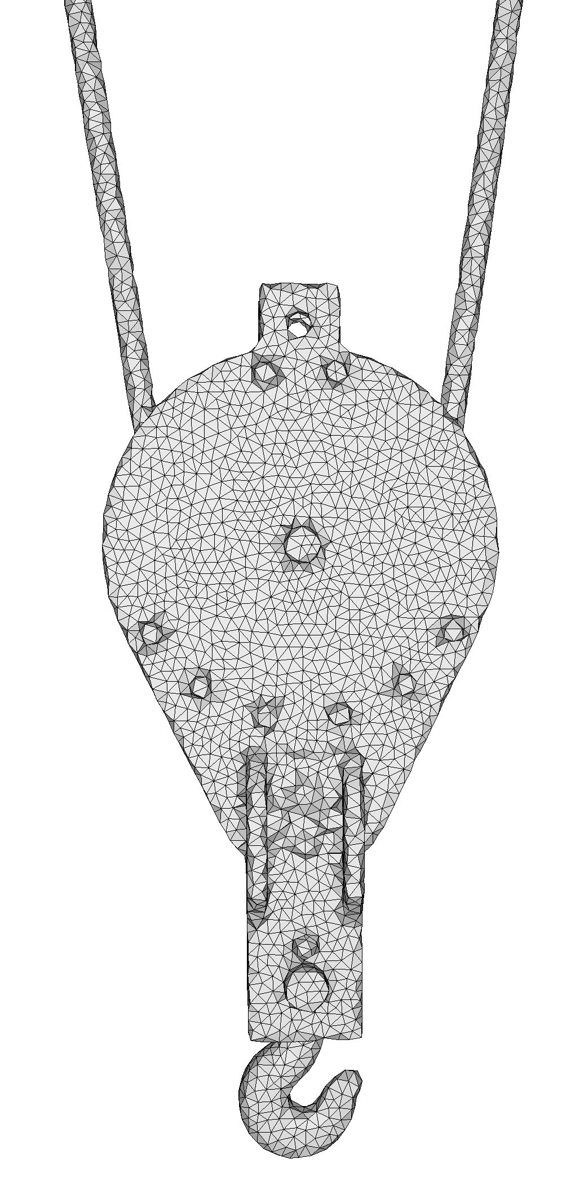
OUTPUT LEVELS of detail (CONT.)

Slide 25
conclusion
Novel wrapper that combines alpha shapes, shrink wrapping, and Delaunay refinement.
Proceed by carving & refining a 3D Delaunay triangulation.
Added value:
Agnostic to input representation (triangle mesh, polygon soup, point cloud, etc.)
Unconditional robustness to defects
Theoretical and practical guarantees
Future work
Sharp features
Local alpha
Conservative simplification
LAB DEMO
Thursday, August 11
11:10 am
West Building, Ballroom A/B
Notes:
Thank you for your attention.
The code is already available in the CGAL library.
Join us at the SIGGRAPH Lab Demo in August for an extensive hands-on demo.

